Slide 1
Ascend AI Processor and Software Stack Basics

Slide 2
Course Goals
Upon completion, you will be able to:
Explain the Huawei Ascend AI full-stack, all-scenario solution.
Describe the hardware platforms in the Ascend solution.
Describe the software architecture and features of the Ascend solution.
Describe the functionality of each tool in the Ascend solution toolchain.
Set up the development and operating environment.

Slide 3

Contents
1
Huawei Full-Stack, All-Scenario AI Solution
2
Hardware Platforms of the Ascend Solution
3
Software Architecture and Features of the Ascend Solution
4
Ascend Toolchain Overview
5
Setup of Development and Operating Environments

Slide 4
Huawei Full-Stack, All-Scenario AI Solution
AI applications
Application enablement
Full-pipeline services (ModelArts), hierarchical APIs, and pre-integrated solutions
HiAI Service
General APIs
Advanced APIs
Pre-integrated solutions
Application enablement
HiAI Engine
ModelArts
Full Stack
MindSpore
Unified training and inference framework for device, edge, and cloud (both standalone and cooperative)
MindSpore
TensorFlow
PyTorch
PaddlePaddle
…
Framework
CANN
Compute Architecture for Neural Networks
Chip enablement
CANN
Built-in operator Lib and highly automated operator development toolkit
Ascend
Ascend-Nano
Ascend-Tiny
Ascend-Lite
Ascend-Mini
Ascend-Max
IP & Chip
Consumer devices
Public cloud
Private cloud
Edge computing
Industrial IoT devices
All Scenarios
Ascend
AI IP and chip series based on a unified, scalable architecture
Notes:
这张图就是华为的全栈全场景AI解决方案。
我们提出的全场景，是指包括公有云、私有云、各种边缘计算、物联网行业终端以及消费类终端等部署环境。
我们说的全栈是技术功能视角，是指包括芯片、芯片使能、训练和推理框架和应用使能在内的全堆栈方案。
华为的全栈方案具体包括：
Ascend： 基于统一、可扩展架构的系列化AIIP 和 芯片，包括Max，Mini，Lite，Tiny和Nano等五个系列。包括华为昇腾910（Ascend 910），是目前全球已发布的单芯片计算密度最大的AI芯片，还有Ascend 310，是目前面向边缘计算场景最强算力的AI SoC
CANN： 芯片算子库和高度自动化算子开发工具
MindSpore：支持端、边、云独立的和协同的统一训练和推理框架
应用使能：提供全流程服务（ModelArts）,分层API和预集成方案

Slide 5
Contents
1
Huawei Full-Stack, All-Scenario AI Solution
2
Hardware Platforms of the Ascend Solution
3
Software Architecture and Features of the Ascend Solution
4
Ascend Toolchain Overview
5
Setup of Development and Operating Environments

Slide 6




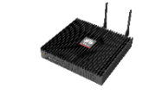
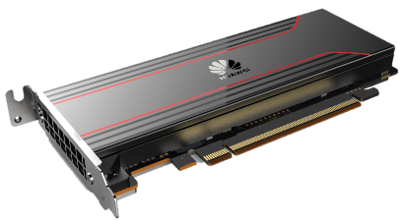

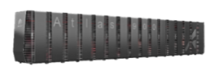
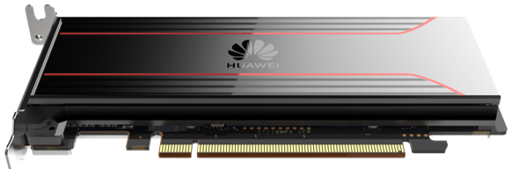




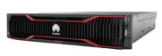
Huawei AI: The Most Powerful AI Computing Platform That Enables Intelligent Transformation
Inference service
Training service
Ascend application enablement
Device
Edge
DC
Service applications
Service applications
Third-Party deep learning system
Third-party cloud platform
IDE
O&M tools
Ascend Developer Zone
MindX
MindX Edge
ModelZoo
SDK
MindX Edge
ModelZoo
SDK
MindX DL
ModelZoo
SDK
AI framework
MindSpore
MindStudio
Heterogeneous compute architecture
CANN 3.0
FusionDirector, SmartKit
Device
Edge
Cloud
Computing resources
Smartphones
Atlas 300I
Atlas 500
Atlas 300I
Atlas 300T
Atlas 900
Da Vinci Architecture
Atlas 200
Smart devices
Atlas 500 Pro
Atlas 800 inference server
Atlas 800 training server
Notes:
在AI算力的硬件基座层面，华为提供了Atlas系列产品，专门用于为AI加速计算。这一系列产品覆盖了端、边、云各类场景，小到消费终端，大到云上数据中心，都能找到对应的产品进行部署。
其中在边侧，可以选择将Atlas200模组集成到您的产品中对AI方面的计算进行加速
也可以将Atlas300产品集成到服务器上进行更高性能的加速计算。
在室外场景，可以选用Atlas500进行推理加速。
在数据中心机房场景下，可以选用Atlas800训练/推理服务器进行部署。
对于超算中心客户，可以选用Atlas900训练集群来加速计算。

Slide 7
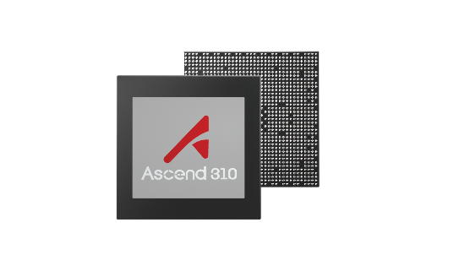
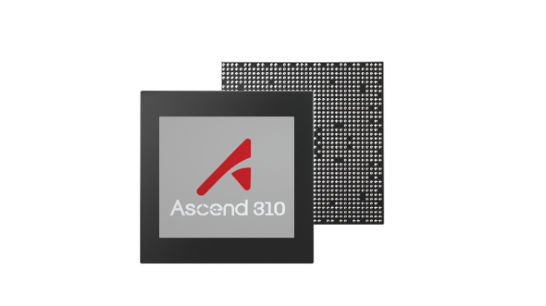
Ascend AI Processors Empower Superior Compute Intelligence
9
FLOPS
256T
4
Ascend 310
Ascend 910
3
AI SoC with ultimate perf./watt
Highest computing density on a single chip
125T
2
90T
45T
Ascend-Mini
Ascend-Max
1
Architecture: Da Vinci
Architecture: Da Vinci
Half-precision (FP16): 11 TFLOPS
Integer precision (INT8): 22 TOPS
16-channel full HD video decoder: H.264/265
Ascend 910
Half-precision (FP16): 256 TFLOPS
Integer precision (INT8): 512 TOPS
128-channel full HD video decoder: H.264/265
* Normalized to 16-bit
1-channel full HD video encoder: H.264/265
Power consumption: 310 W
Power consumption: 8 W
Process: 7 nm
Process: 12 nm
Notes:
讲解要点：
面对汹涌而至的AI需求，业界目前被少数公司所垄断，价格昂贵，供货周期长，本地服务支持能力弱，很多行业的AI需求无法得到有效满足。
华为在2018年10月份的全联接大会上发布了针对AI推理与训练场景的昇腾310与昇腾910芯片。昇腾芯片独特的达芬奇3D Cube架构，使得芯片具有高算力、高能效、可扩展的优点。
昇腾310芯片，是用于推理的边缘智能场景的极致高能效AI SoC，使用12nm制作工艺，可提供22TOPS的算力，且功耗只有8瓦，非常适合边缘计算的低功耗要求的场景；
昇腾910芯片，是当前计算密度最大的单芯片，适用于AI训练，采用7nm制作工艺，可提供512TOPS的算力，最大功耗为350瓦。

Slide 8
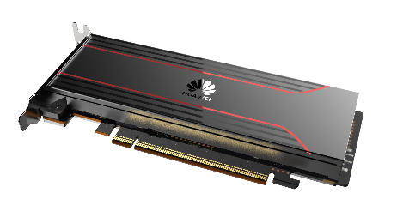
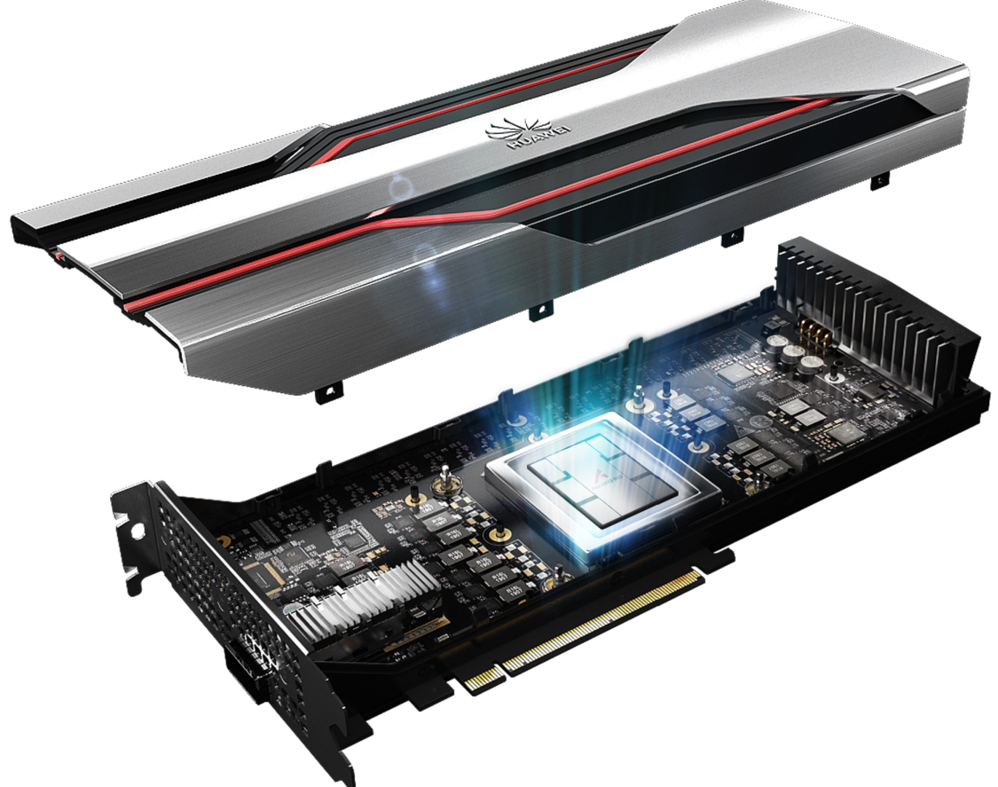
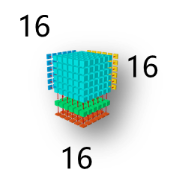
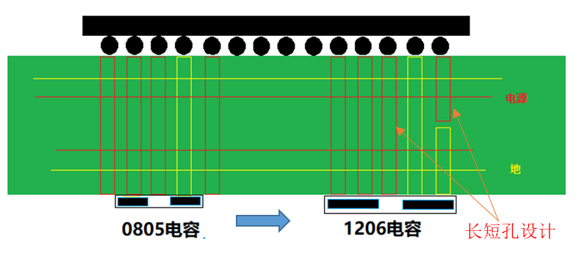
Superior compute power
Da Vinci Architecture Unlocks Robust AI Compute Power
Atlas 300I: Most Powerful Video Analysis Inference Card
Atlas 300T: Highest Performance Training Card
280T
320T
Compute power: 1.33 times that of competitors
112T
125T
Video analysis channels: twice that of competitors
Competitors
Atlas 300T
Operations per clock cycle
130,172 operations
Ladder board with long and short holes
1047 μF capacitor
14-phase power supply
1000 A/µs load current change
Power
Compute power (INT8) per card
Number of full HD video channels per card
GND
0805 capacitor
1206 capacitor
Long and short vias

Slide 9
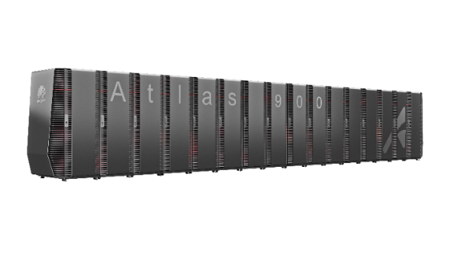
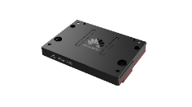
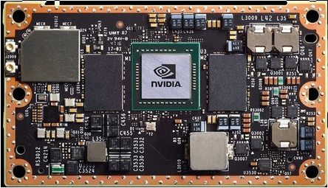
Superior compute power
Optimal Heat Dissipation, Higher Energy Efficiency
Atlas 200 AI Accelerator Module
Atlas 900 AI Cluster
Intelligent analysis at the edge with ultra-low power consumption
The first full liquid cooling AI cluster
Energy efficiency ratio: 6 times that of competitors
AI cluster with PUE reduced by about 30%
PUE
Atlas 900
<1.1
Up to 22 TOPS
2.6 TOPS
8 W
7.5–15 W
Air-cooled cluster competitors
PUE
Atlas 200
Competitors
1.5
>2 TOPS/W
0.17–0.34 TOPS/W
Cooling capacity per rack
Number of cabinets
Total power consumption
>2 TOPS/W
<100 mW hibernation power consumption
–25°C to +80°C
50 kW
16 racks
704 kW
Da Vinci Architecture
Superior perf./watt
4-level power consumption
Wakeup in ms
Wide temperature range
30 kW
86 racks
1728 kW

Slide 10
Contents
1
Huawei Full-Stack, All-Scenario AI Solution
2
Hardware Platforms of the Ascend Solution
3
Software Architecture and Features of the Ascend Solution
4
Ascend Toolchain Overview
5
Setup of Development and Operating Environments

Slide 11
CANN: Ascend Software Stack with Leading Performance, Efficient and Open
Application
enablement
Compute Architecture for Neural Network (CANN) is a Huawei-designed AI-oriented heterogeneous parallel computing architecture that provides hierarchical APIs to streamline the development of AI applications and services on the Ascend platform.
CANN architecture:
Model and operator development stack that enables development using the AscendCL and TBE APIs and supports execution instruction conversion with ATC.
Application execution stack that runs efficiently on the Ascend heterogeneous platform by working with the Task Scheduler.
CANN highlights:
Efficient development through hierarchical APIs, comprehensive debug and tuning tools.
Superior performance endorsed by the data-driven hardware scheduling solution.
Full openness powered by 9 open designs with full-scenario E2E coverage.
Industry demo
General APIs
Advanced APIs
Pre-integrated solutions
MindX
ModelArts
PyTorch, TensorFlow, ...
MindStudio toolchain
FusionDirector and SmartKit O&M
Application execution stack
Model and Op development stack
CANN
Infrastructure
software
AscendCL-Run
AscendCL-Graph
ATC compiler
Runtime
Media preprocessing
Graph compiler
Built-in Op Lib
Task Scheduler
Operator compiler
Hardware
NPU driver
Atlas module/card/edge station/server/cluster
Ascend 910/310

Slide 12
CANN Openness: 9 Open Designs with Full-Scenario E2E Coverage
All-inclusive development portals: powered by 9 open designs covering model, application and operator development.
Comprehensive toolchain: improves development efficiency in model analysis, code development, debugging, tuning, and diagnosis.
Complete open source: opens all model scripts, operator codes, and application demo code.
Model development
(MindSpore, ...)
Ctrl CPU
Graph fusion and optimization
AI Core Op development
IR graph building
Third-party framework
adaptation
Industry applications
No. | Metric | Highlights
 | ModelZoo: built in with a large number of pre-trained models | Ready to use, retrain, or fine-tune
 | Ctrl CPU openness | Supports application software execution on the ARM CPU of the Ascend AI Processor.
 | Open graph fusion and optimization APIs | Supports efficient customization of operator fusion rules.
 | Open IR graph APIs | Supports efficient customization of models.
 | Third-party mainstream framework adaptation | Third-party framework adaptation, such as TensorFlow, PyTorch and Caffe.
 | Encapsulated hardware acceleration APIs for industry applications | Facilitates the utilization of AI compute power.
 | Open-source Graph Engine (GE) | Supports efficient customization of GE code.
 | TBE operator development system | Supports efficient development of custom operators.
 | Built-in open-source Op Lib | Simplifies operator customization.
1
2
3
4
5
6
1
CANN
Unified API (AscendCL)
2
ModelZoo
ATC compiler
3
GE (open-source)
Graph optimization and build
7
4
FE
AICPUE
HCCL
5
Operator build
TBE
TBE Lib
(open-source)
6
8
9
7
Runtime
Driver
8
Compute resources (Ascend 310/ Ascend 910, AI CPU, Ctrl CPU)
9

Slide 13
MindX: Edge-oriented Solution and DC-oriented Solution
Industry
use cases
Supercomputing
Carriers
Public safety
Finance
Smart grid
Internet
MindX is a Huawei-designed enabler for industry AI applications. It provides the ModelZoo and highly integrated MindX SDK to deliver Intelligent Edge and DC solutions, supporting rapid development of AI applications and services on the Ascend platform.
Open ecosystem
MindX integrates 5+ industry SDKs, 60+ pre-trained models, and a range of platform reference designs.
Edge-cloud synergy
MindX enables a DC training+edge inference solution with a unified model development and deployment architecture and supports model protection and encryption to guarantee E2E security and reliability.
Intelligent Edge Solution
DC Solution
Application
enablement
MindX
MindStudio toolchain
FusionDirector and SmartKit O&M
ModelZoo
MindX SDK
MindX DL
MindX Edge
Infrastructure
software
MindSpore
PyTorch, TensorFlow, ...
CANN
Application execution stack
Model and Op development stack
Hardware
NPU driver
Atlas module/card/edge station/server/cluster
Ascend 910/310

Slide 14
MindX: A Streamlined Solution with Modular Design
ModelZoo
Runtime
Runtime workflow:
Data collection, upload, and storage
Data filtering and labeling
Algorithm model training
Semi-automatic data annotation
Auto model update on DC
Inference service deployment on DC
Inference service monitoring on DC
Inference service execution on DC
Auto model update at edge
Inference service deployment at edge
Inference service monitoring at edge
Inference service execution at edge
Development workflow:
Develop the training platform with MindX DL.
Develop the reference platform with MindX Edge.
Obtain models from the training platform and develop inference services.
Deploy the inference service on the inference server.
Obtain models to train from ModelZoo.
Obtain inference information from ModelZoo.
Typical scenarios:
DC training -> DC inference
DC training -> Edge inference
For training
Data source (device)
Data source 1
Data source 2
...
Data source N
Model 1
1
Data labeling
8
12
Model 2
Big data storage
2
Data labeling client 1
4
DC inference platform
Edge inference platform
...
...
DC inference service
(Servers 1–N)
Edge inference service
(Servers 1–N)
Model N
5
Data labeling client N
3
10
6
7
11
For inference
Training platform (cloud/DC)
5
DC management platform
Edge service management platform
AI training service
(Server 1)
...
Inference service deployment on DC
AI service deployment
AI service monitoring
2
Model 1
AI training service
(Server N)
9
Development time
Model 2
1
3
4
4
...
MindX DL
MindX SDK
(mxManufacture, mxVision)
MindX Edge
Training
Labeling
Obtain model files
Build preprocessing and postprocessing source code.
Integrate custom plug-in to pipeline
Pack AI inference service
Inference
Management
Model N
DLS Core
Middleware
6
Notes:
中心推理与边缘推理选择：如果以下诉求则推荐边缘推理，否则采用中心推理方案：
节点在内网，不能从中心直接访问节点，需要从节点向中心发起连接
节点与中心网络不稳定，在网络断开后，需要保证节点业务不受影响
节点资源受限，需要轻量化agent

Slide 15
MindSpore Solution
Unified APIs for all scenarios
Easy to use: unified build
Unified IR and build of networks and operators
Auto parallelism for complex networks
Auto differentiation for networks and operators
Accurate, visualized auto tuning
High-performance: full-stack build acceleration with software and hardware synergy
MindSpore IR for unified fusion and optimization of graphs and operators.
Deep graph optimization with Ascend software and hardware synergy
All scenarios: on-device inference + DC training
Lightweight and low latency (IoT applicable)
Auto-adaptive model generation based on device information
Quantization during training with proper quantization precision and lowered compute overhead
Auto differentiation
Auto parallelism
Auto tuning
Business Number 02
MindSpore IR for computational graphs
On-device execution
Pipeline parallelism
Deep graph optimization
Device-edge-cloud collaborative distributed architecture (deployment, scheduling, communications, ...)
Processors: Ascend, GPU, CPU
MindSpore is a Huawei-designed deep learning framework that best matches the compute power of the Ascend AI Processor. By enabling flexible deployment across device-edge-cloud with industry's best practices integrated, MindSpore upgrades user experience and lowers development threshold, bringing pervasive AI to every home, person, and organization.
Notes:
MindSpore是华为自研最佳匹配昇腾处理器算力的全场景AI计算框架，支持终端、边缘、云灵活部署，提供更好的用户体验和更高的开发效率，降低开发门槛，让AI无所不及。

Slide 16
Contents
Contents
1
Huawei Full-Stack, All-Scenario AI Solution
2
Hardware Platforms of the Ascend Solution
3
Software Architecture and Features of the Ascend Solution
4
Ascend Toolchain Overview
5
Setup of Development and Operating Environments

Slide 17
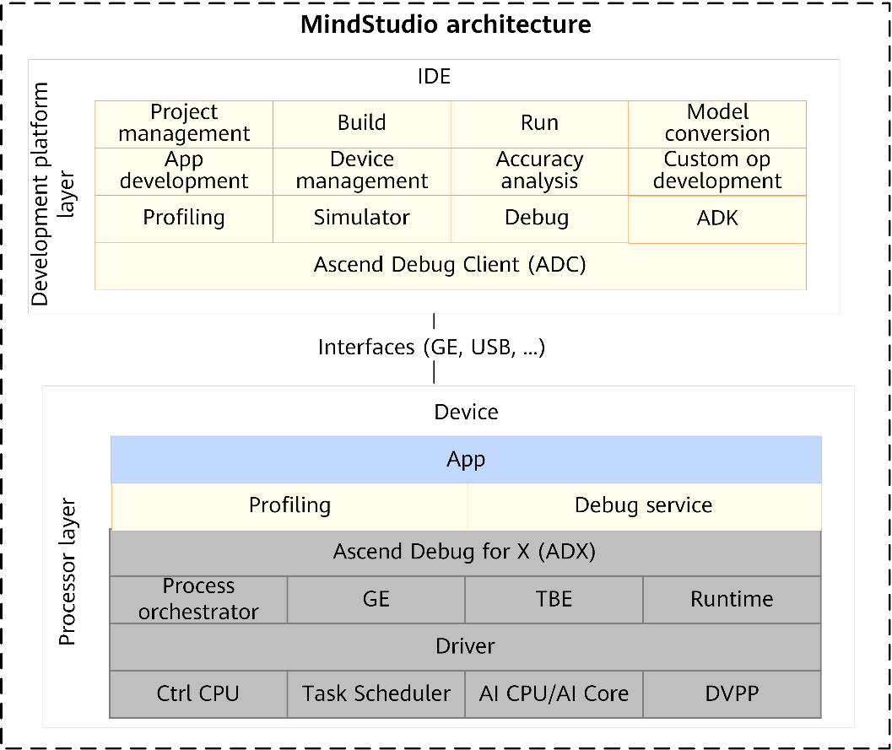
1. MindStudio
MindStudio is an IntelliJ-based integrated development environment (IDE). It enables application development and debugging and model conversion. It also supports network porting, optimization, and profiling, facilitating application development.
MindStudio provides a portfolio of operator development and optimization capabilities. Custom operators can be developed using the toolchain provided by MindStudio, which lowers the operator development threshold, facilitates operator development, debugging, and optimization, and thus enhances product competitiveness.
For network model development, MindStudio integrates the Ascend Tensor Compiler (ATC), Ascend Model Compression and Training Toolkit (AMCT), Model Accuracy Analyzer, Profiling tool, and Log tool, boosting the efficiency of porting, analysis, and optimization of network models.
For compute engine development, MindStudio is preset with typical compute engine code such as classification networks and detection networks, which lowers the technical threshold for developers and accelerates the development and porting of AI algorithm engines.
For application development, MindStudio offers a range of tools such as the Profiler and Compiler. Developers can implement E2E development ranging from project management, building, and debugging, to performance analysis in a graphical IDE.

Slide 18
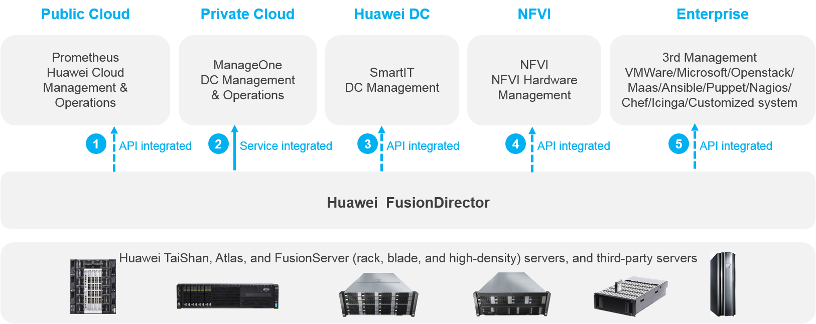
2. FusionDirector
FusionDirector enables unified O&M for Huawei and third-party servers as well as Huawei edge devices. Public cloud and enterprise customers can use FusionDirector to perform simple and efficient O&M for servers and Huawei edge devices in each phase of the lifecycle to obtain ultimate experience.
FusionDirector implements visualized management and fault diagnosis for servers, and provides lifecycle management capabilities such as device management, device configuration, firmware update, device monitoring, and OS deployment for Huawei servers, helping O&M personnel improve O&M efficiency and reduce O&M costs.
FusionDirector can be widely used for public clouds, private clouds, and data centers, and can provide service for carrier, and enterprise customers. It can be deployed in various scenarios such as AI, HPC, Internet, and Safe City.
It also provides standard Native Redfish interfaces to integrate or interconnect with customer systems.

Slide 19
3. DSMI APIs
Device System Manage Interface (DSMI) provides APIs for Ascend AI Processor management, including device, MAC address, fan module and configuration management, software upgrade as well as processor reset and boot. By calling these APIs, you can obtain the Ascend AI Processor quantity, health status, temperature, sensor, fan module and much more, facilitating the monitoring of Ascend AI Processors.
APIs are classified into two classes:
Query APIs: dsmi_get_xxx, dsmi_query_xxx, dsmi_list_xxx
Setting APIs: dsmi_set_xxx, dsmi_clear_xxx, dsmi_enable_xxx
Usage:
Copy the dsmi_common_interface.h file and source code file from the /usr/local/Ascend/driver/include directory on the host to the same directory on the developer board.
Run the build command: gcc xxx.c /usr/local/Ascend/driver/lib64/libdrvdsmi_host.so -L. -o xxx
Examples:
Build the code:
gcc get_device_health.c /usr/local/Ascend/driver/lib64/libdrvdsmi_host.so -L. -o get_device_health
Execute the code:
./get_device_health -p 1

Slide 20

4. Log
Log generation:
Collect logs.
The sklogd and slogd processes collect user-mode and kernel-mode logs. The log driver collects non-Ctrl CPU logs.
Output logs to files.
Device-side logs are output to files by log-daemon, with file names prefixed with device-id or device-os-id. Host-side logs are output to files by slogd and sklogd, with file names prefixed with host-0.
Naming conventions:
Device-side Ctrl CPU logs: /var/log/npu/slog/device-os-id/device-os-id_*.log
Device-side non-Ctrl CPU logs: /var/log/npu/slog/device-id/device-id_*.log
Host-side user-mode and kernel-mode logs: /var/log/npu/slog/host-0/host-0_*.log
Notes:
Log files prefixed with device-id store device-side non-Ctrl CPU logs.
Log files prefixed with device-os-id store device-side Ctrl CPU logs, including user-mode logs and kernel-mode logs.
The log directory is unavailable in the Ascend RC environment. Instead, the logs are output to log files in the host-0 directory.
Examples:

Slide 21
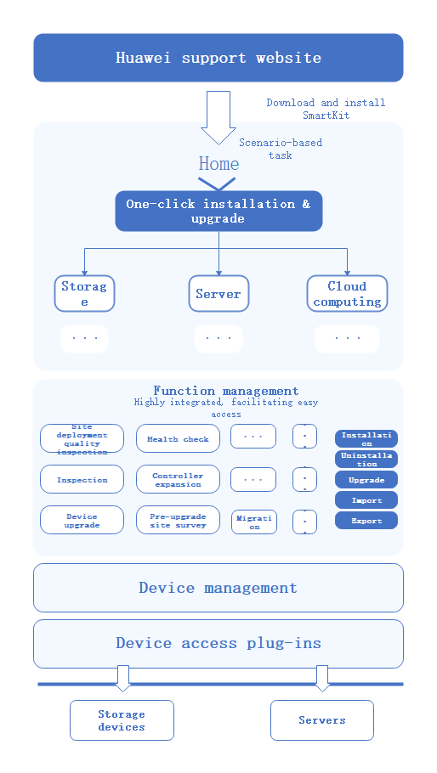
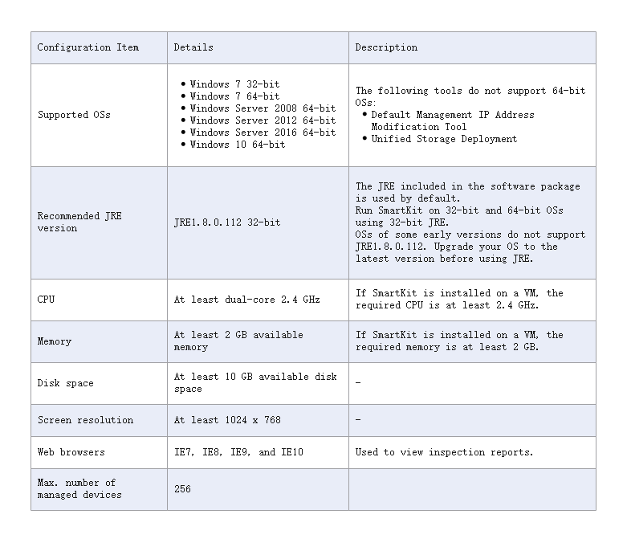
5. SmartKit
SmartKit is a unified service toolkit for products in the storage, server, and cloud computing fields, with features of OceanStor Toolkit incorporated.
SmartKit integrates various tools required for deploying, maintaining, and upgrading IT devices, helping service and maintenance engineers perform precise operations on these devices, improving work efficiency. The figure shows the SmartKit workflow.
In SmartKit, supported devices vary depending on different functions. After a function runs, you can click List of Supported Devices in the Add Devices or Select Devices step to view the models and versions of supported devices.

Slide 22
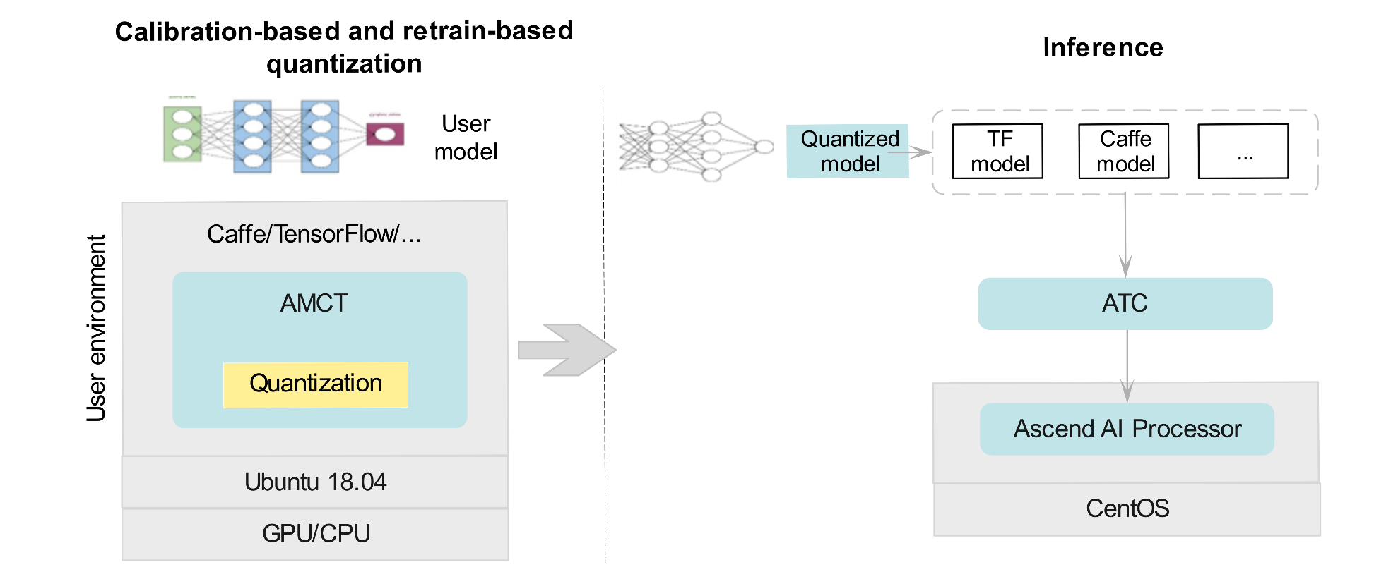
6. AMCT
The Ascend Model Compression and Training Toolkit (AMCT) reduces the precision of model parameters (or weights) to make the model more compact, minimizing the transfer latency and improving the compute efficiency. The figure shows the AMCT workflow.
Based on the quantization method, quantization is classified into calibration-based quantization and retrain-based quantization.
The foregoing two quantization methods are classified into weight quantization and data quantization according to the quantization object, and are classified into uniform quantization and non-uniform quantization (only uniform quantization is supported) according to whether weight data is compressed.

Slide 23
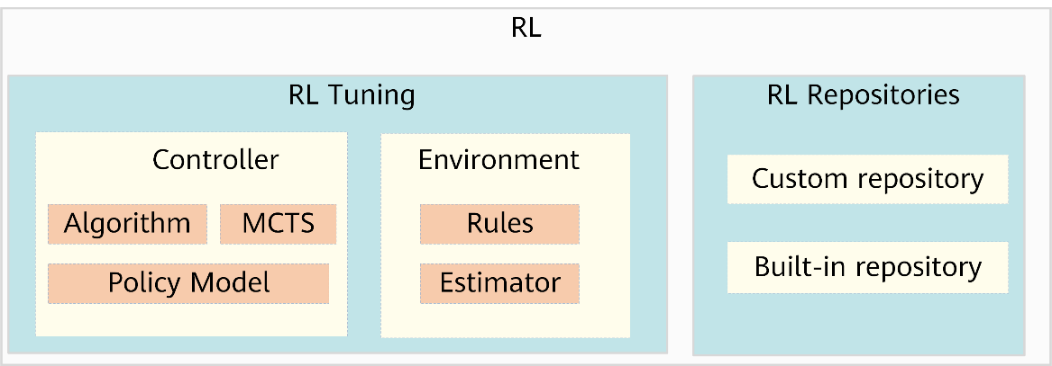
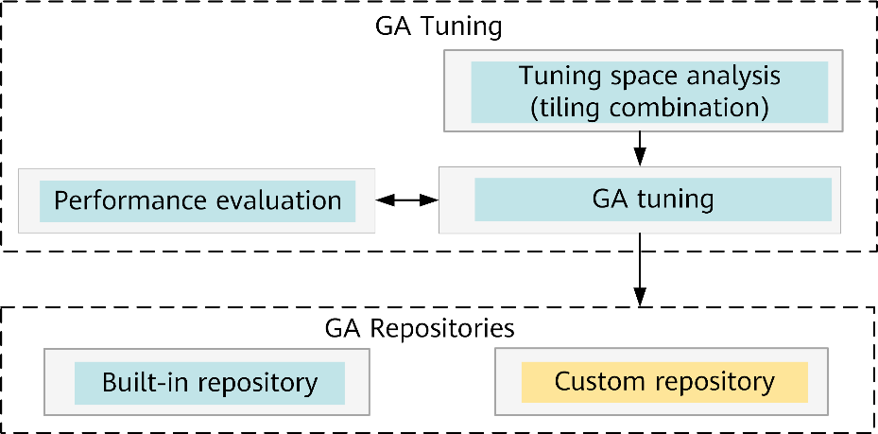
7. Auto Tune
Auto Tune can automatically tune operators by leveraging hardware resources. During the generation of your network model, you only need to enable auto_tune_mode to enable the Auto Tune tool. Then, this tool can be automatically called for operator tuning during operator build, and the tuning result is stored in the custom repository. After that, the operator can achieve the tuned performance when it is called again. Auto Tune supports the two tuning modes: Reinforcement Learning (RL) tuning and Reinforcement Learning (RL) tuning.
The RL tuning mode supports elewise, broadcast, and reduce operators. The schedule process is abstracted as a decision chain based on Monte Carlo tree search (MCTS), a heuristic search algorithm for some kinds of decision processes, and then employs RL-trained Neural Networks (NNs) to guide decision-making.
RL consists of two parts, RL Tuning and RL Repositories.
The GA tuning mode supports cube operators. A tuning space is generated through multi-level combinations with manual experience for pruning and sorting, improving tuning efficiency. GA is employed to tune parameters in rounds to obtain the optimal tiling policy.
The GA tuning process is as follows: (1) analyze the tuning space; (2) perform tuning using the genetic algorithm; (3) obtain the optimal tiling policy and add it to the repository.

Slide 24
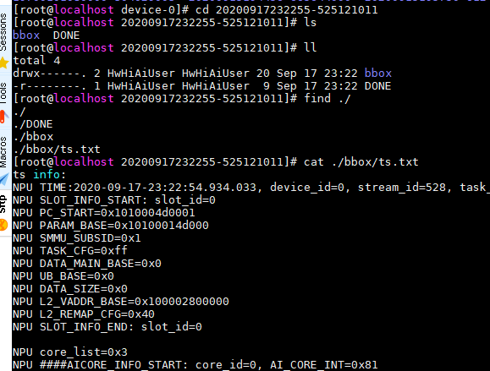
8. Black Box
The Black Box mechanism enhances the system maintainability of Ascend AI Processor and preserves the necessary software and hardware parameters when an exception occurs in the system, facilitating fault diagnosis and analysis as well as quick fault locating. Currently, the following modules support the Black Box function: BIOS, LPM, TEE, ATF, TS, Driver, DVPP, and OS.
Configuration:
Find the Black Box configuration file in /var/log/npu/conf/bbox/bbox.conf. The following table lists the variables to be configured.
Variable | Description
MNTN_PATH=/var/log/npu/hisi_logs | Path for storing the Black Box logs. The path cannot contain relative path /../ and the path length cannot exceed 64 bytes.
MNTN_LOGSPACE_SIZE=64 | Available space size for storing log files of each SoC. The unit is MB. The size range is 20 MB to 3 GB.
Log directory:
Black Box log files are stored in the /var/log/npu/hisi_logs/device-id/ directory.
File history.log:
The history.log file records the historical errors with timestamps, as shown in the right figure.

Slide 25
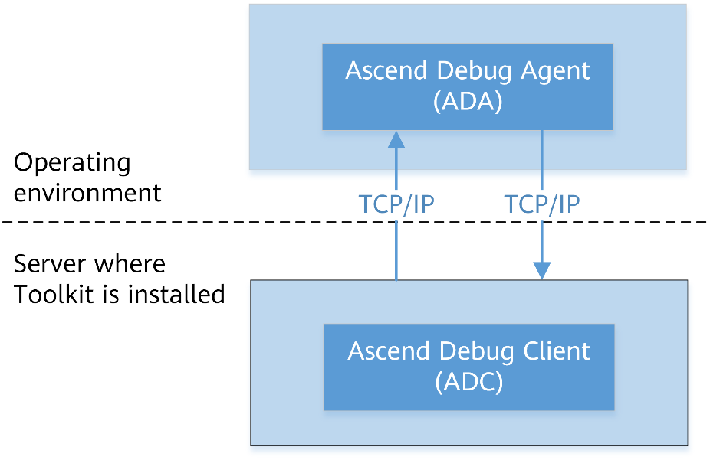
9. ADC and ADA
The adc command is provided to implement functions such as file transfer, log level setting, and heartbeat detection through the communication between the Ascend Debug Client (ADC) and Ascend Debug Agent (ADA). The adc command is executed on the server where Toolkit is installed and is then delivered to the operating environment for execution.
Abbreviation mapping:
ADC: Ascend Debug Client, corresponding to the adc command
ADA: Ascend Debug Agent. The corresponding process name is ada.
ADX: Ascend Debug for X, a module name.
Pay attention to the following:
In the Ascend EP scenario, ADA is deployed on the host, which is also the operating environment.
In the Ascend RC scenario, ADA is deployed on the developer board, which is also the operating environment. In addition, you can run the adc command in the operating environment without installing Toolkit.
Use cases:
Heartbeat detection and log level settings

Slide 26
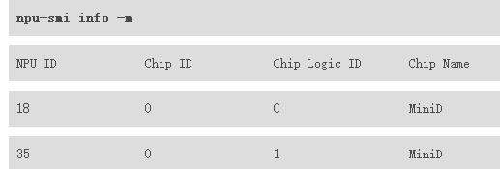
10. npu-smi
npu-smi is an NPU system management tool. It can be used to collect Atlas 300I Inference Card or Ascend 310 AI Processor, view the usage of the video RAM, enable and disable the NPU configuration option, and update firmware. For NPU 20.0.0 and later versions, some npu-smi commands can be delivered to VMs.
Commands are provided to query the processor version, monitor the processor status, resource usage, temperature, power consumption, and voltage, as well as collect logs.
Installation:
Download the latest Driver and installation package from https://www.huaweicloud.com/ascend/resource/Software. The default installation path is /usr/local/sbin/.
Command-line options:
Use cases:
1. Query the monitoring data of all chip or a single chip:
npu-smi info watch -i id -c chip_id -d delay_seconds -s watch_type
2. Query all NPU devices:
npu-smi info -l
3. Query the chip mapping relationship:
npu-smi info -m
Option | Description
info | Queries information.
set | Configures the chip occupation mode and video RAM, or resets a chip.
upgrade | Upgrades the configuration and queries the upgrade status.
-h | Displays the help information.
-v | Displays the version of the npu-smi tool.

Slide 27
Contents
1
Huawei Full-Stack, All-Scenario AI Solution
2
Hardware Platforms of the Ascend Solution
3
Software Architecture and Features of the Ascend Solution
4
Ascend Toolchain Overview
5
Setup of Development and Operating Environments

Slide 28
Introduction
This lesson provides instructions for setting up the development and operating environment based on the Ascend AI solution and describes the UI elements of the MindStudio IDE.
This lesson is organized into four parts:
Atlas 200 DK Environment Setup
Atlas 300 Environment Setup
MindStudio Features Walkthrough
You are expected to have familiarity with basic Linux commands, Ubuntu basics, and be able to switch between users, enter and exit directories, and modify file content.

Slide 29
Atlas 200 DK Environment Setup

Slide 30
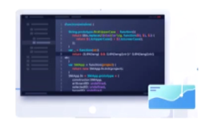



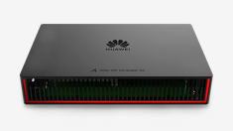
Setting up Development and Operating Environments
Development environment
Operating environment
Layer 2 Software layer
MindStudio
Driver, Firmware, rufiles, ...
Layer 1 OS layer
Ubuntu-18.04.4-desktop-amd64
Ubuntu-18.04.4-server-amd64
Layer 0 Hardware layer
Notes:
跟其他编程语言一样，昇腾/Atlas系列设备的开发和运行环境也是可以分开的。在开发环境上开发代码，编译成二进制；在运行环境上运行。除了开发和编译之外，开发环境上的工具还能实现其他的一些功能，诸如模型转换、设备管理 （即运行环境管理）、精度比对、profiling等等。而运行环境则除了基本的应用运行之外，还能运行某些调试、信息收集工具等，以辅助代码的调试调优、问题定位。
开发环境可自行选用任何计算机，笔记本、台式机、服务器均可，但要注意，操作系统必须是Ubuntu18.04.4-desktop-amd64，只有在这个操作系统上才能正常运行开发环境的核心组件——MindStudio。
Atlas300和华为云Ai1产品本质上是一样的，安装过程也基本完全一致，这里为了简化操作，选用华为云Ai1产品来进行讲解。
Ai1产品的通用CPU是x86架构的，故其操作系统需要是Ubuntu-18.04.4-server-amd64而非arm64.

Slide 31
Setting up the Development Environment
Install OS
Install Toolkit
Install MindStudio
Notes:
搭建开发环境总体分三个步骤，即安装操作系统，安装开发套件以及安装MindStudio。
其中，安装操作系统部分，请自行安装Ubuntu18.04.4-desktop-amd64系统到您的计算机上，本课程暂不展开讲解。
安装开发套件和MindStudio会在下文中详细进行展示。

Slide 32
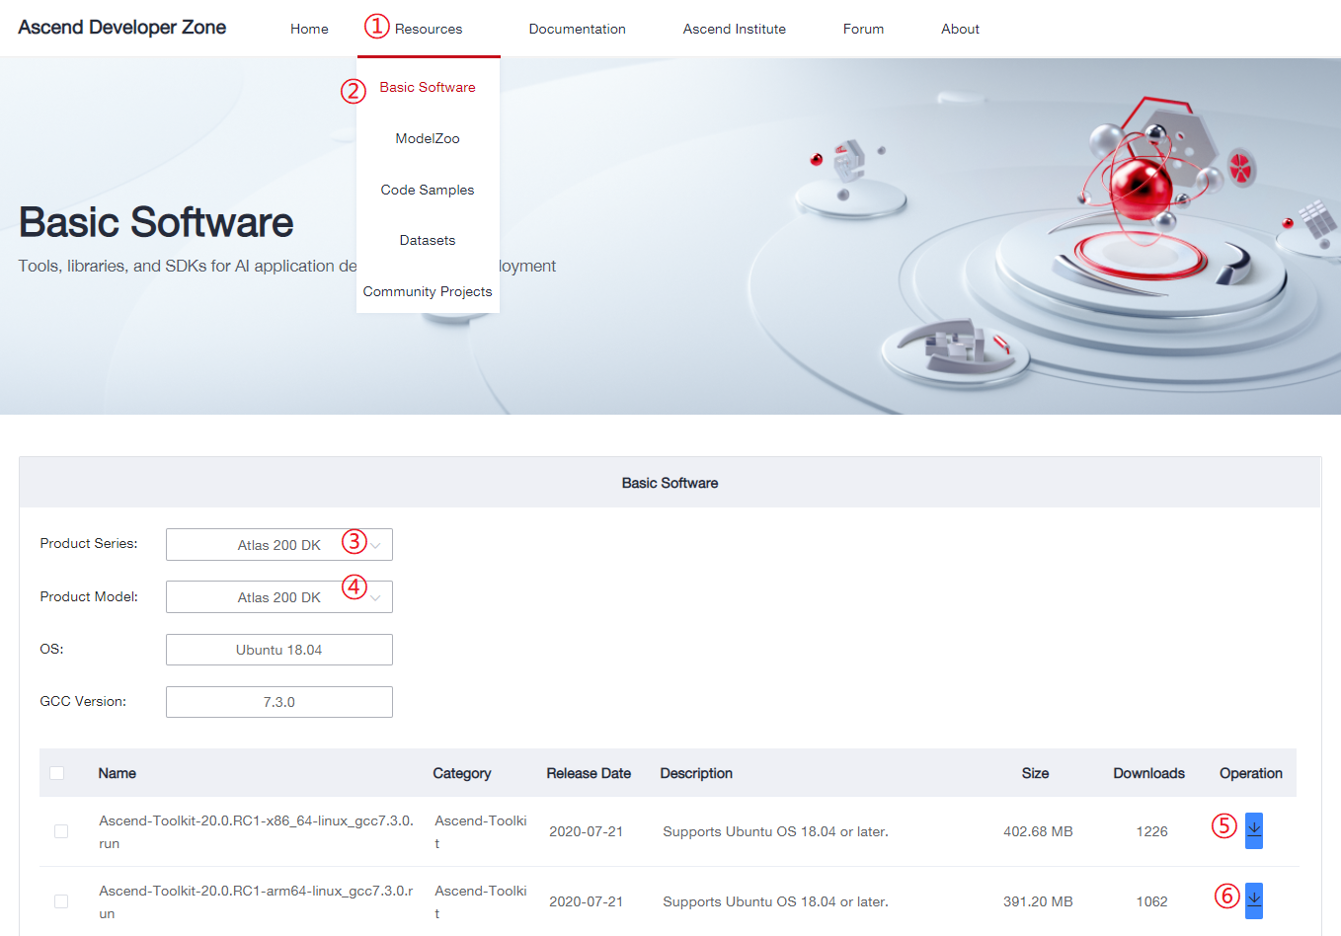
Installing Toolkit – Downloading Runfiles
https://www.huaweicloud.com/intl/en-us/ascend/resource/Software
Notes:
下载搭建开发环境需要的软件包。
访问屏幕下方的网址，进入昇腾开发者社区的资源中心->基础软件下载，（①②）
③：“产品系列”选择“Atlas200DK”，
④“产品型号”选择“Atlas200DK”，
然后下载两个以“Ascend-Toolkit”开头的包（即⑤⑥）。
其中x86-64版本的是承载开发环境某些工具的，而arm64版本则用于编译能够运行在Atlas200DK上的可执行文件。

Slide 33
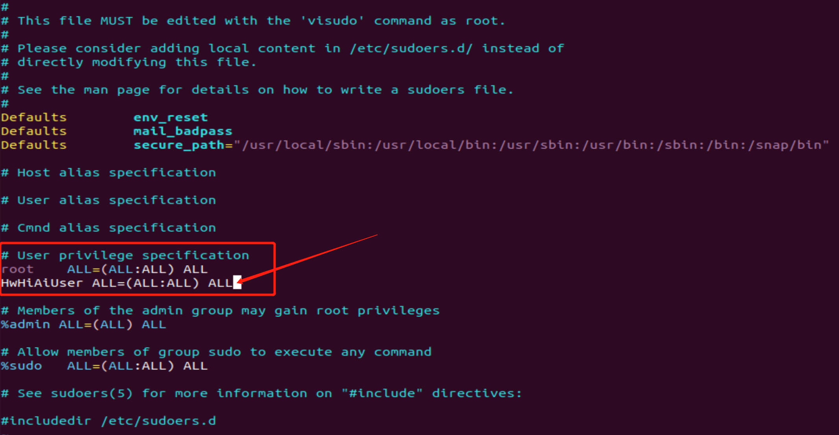
Installing Toolkit – Installing Dependencies
Perform the following operations as the root user:
Modify the /etc/sudoers file.
Add the following line under # User privilege Specification:
username: ALL=(ALL:ALL) ALL
Notes:
做这一步是为了能够在HwHiAiUser用户下使用sudo命令，以root权限执行某些命令

Slide 34
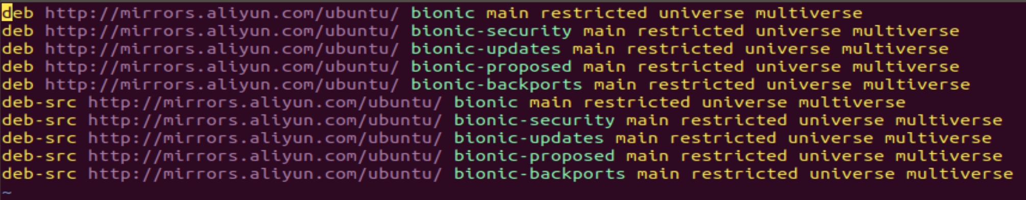
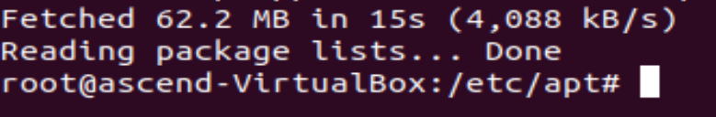
Installing Toolkit – Installing Dependencies
Perform the following operations as the root user:
Modify the /etc/apt/sources.list file.
Replace the ubuntu18.04-amd64 source addresses with valid ones.
Save the file and run the following command: apt-get update
If messages similar to the following are displayed, the execution is successful.
Notes:
做这一步是为了让大家在国内下载ubuntu上的软件，也就是在国内用apt-get命令获取软件的速度能够快一些。

Slide 35
Installing Toolkit – Installing Dependencies
Perform the following operations as a common user:
1. Install the dependencies:
sudo apt-get install -y gcc g++ make cmake zlib1g zlib1g-dev libsqlite3-dev openssl libssl-dev libffi-dev unzip pciutils net-tools libblas-dev gfortran libblas3 libopenblas-dev g++-aarch64-linux-gnu
2. Install Python 3.7.5:
wget https://www.python.org/ftp/python/3.7.5/Python-3.7.5.tgz
tar -zxvf Python-3.7.5.tgz
cd Python-3.7.5
./configure --prefix=/usr/local/python3.7.5 --enable-shared
make
sudo make install
sudo cp /usr/local/python3.7.5/lib/libpython3.7m.so.1.0 /usr/lib
sudo ln -s /usr/local/python3.7.5/bin/python3 /usr/bin/python3.7
sudo ln -s /usr/local/python3.7.5/bin/pip3 /usr/bin/pip3.7
sudo ln -s /usr/local/python3.7.5/bin/python3 /usr/bin/python3.7.5
sudo ln -s /usr/local/python3.7.5/bin/pip3 /usr/bin/pip3.7.5
Notes:
当前版本的开发套件依赖Python3.7.5这一特定python版本，此版本暂时无法通过apt-get直接获取，故通过编译安装的方式来安装。

Slide 36
Installing Toolkit – Installing Dependencies
Perform the following operations as a common user:
1. Create a .pip directory in the $HOME directory.
cd ~; mkdir .pip; cd .pip
2. Create a pip.conf file in the .pip directory and fill in the following content (you can also choose other pip sources):
[global]
index-url = http://pypi.douban.com/simple
[install]
trusted-host = pypi.douban.com
3. Save the pip.conf file.
4. Install the dependencies:
pip3.7.5 install attrs psutil decorator numpy protobuf==3.11.3 scipy sympy cffi grpcio grpcio-tools requests --user
Notes:
上边三个命令是为了让我们在国内使用pip命令安装python包的速度快一些，命令4则是安装一些必要的python依赖。

Slide 37
Installing Toolkit – Executing Runfiles
Perform the following operations as a common user (for example, ascend):
1. Go to the runfile directory.
2. Add the execute permission on the runfiles:
chmod +x *.run
3. Execute the runfiles:
./Ascend-Toolkit-20.0.RC1-x86_64-linux_gcc7.3.0.run --install
./Ascend-Toolkit-20.0.RC1-arm64-linux_gcc7.3.0.run --install
4. If messages similar to the following are displayed, the installation is successful.
Notes:
前边的准备工作都是为了安装这两个软件包，而这两个包安装完毕也就就意味着开发套件安装完毕了，接下来是安装MindStudio的过程。

Slide 38
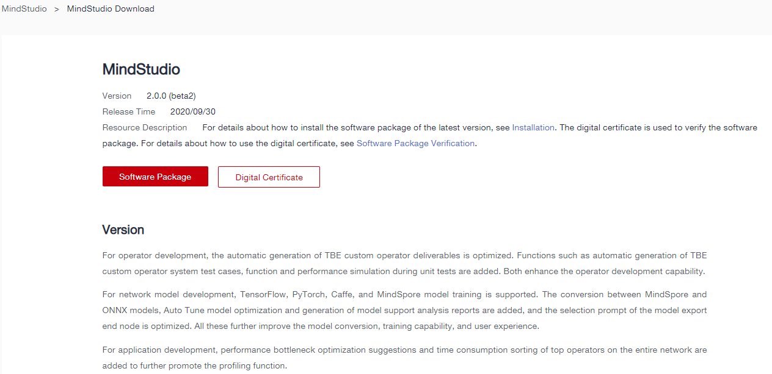
Installing MindStudio – Downloading tar.gz. Package
Download MindStudio 2.0.0 (beta2) from https://www.huaweicloud.com/intl/en-us/ascend/resources/tools/mindStudio/download.
The name of the downloaded package should be MindStudio_2.0.0-beta2_ubuntu18.04-x86_64.tar.gz.

Slide 39
Installing MindStudio – Installing Dependencies
Perform the following operations as a common user:
1. Install the system dependencies:
sudo apt-get install -y gcc g++ make cmake unzip zlib1g-dev libbz2-dev libsqlite3-dev libssl-dev libxslt1-dev libffi-dev xterm firefox xdg-utils fonts-droid-fallback fonts-wqy-zenhei fonts-wqy-microhei fonts-arphic-ukai fonts-arphic-uming openjdk-8-jdk
2. Install the Python dependency:
pip3.7.5 install attrs psutil decorator numpy protobuf==3.11.3 scipy sympy cffi gnureadline coverage pylint matplotlib PyQt5==5.14.0 grpcio grpcio-tools requests tensorflow==1.15 --user
3. Append the following two lines to the ~/.bashrc file and save the file:
export JAVA_HOME=/usr/lib/jvm/java-8-openjdk-amd64
export PATH=$JAVA_HOME/bin:$PATH
4. Run the following command:
source ~/.bashrc
Notes:
以上这些软件依赖是安装MindStudio的必要条件。

Slide 40
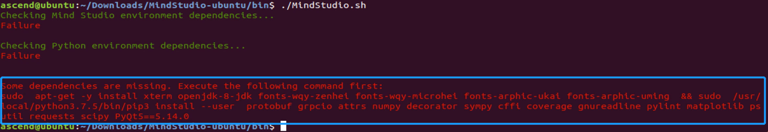
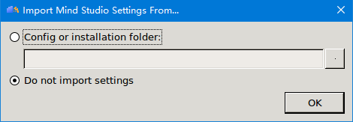
Install MindStudio
Perform the following operations as a common user:
1. Go to the directory where MindStudio_2.0.0-beta2_ubuntu18.04-x86_64.tar.gz is stored and run the following command:
tar zxvf MindStudio_2.0.0-beta2_ubuntu18.04-x86_64.tar.gz; cd MindStudio-ubuntu/bin;./MindStudio.sh
2. If command outputs similar to the following are displayed, run the command as prompted.
3. After MindStudio is launched for the first time, the Import MindStudio Settings dialog box is displayed. Select Do not import settings and click OK.
Notes:
上一页的软件依赖是针对写这篇文档时的软件版本的，如果软件版本发生更新，上边那些命令未必能覆盖MindStudio所需要的全部依赖，不过好在MindStudio会在启动前检查自己所需要的依赖软件有没有正确安装，如果没有，MindStudio会在命令行给出安装依赖的命令，只需要复制红字命令来执行即可。

Slide 41
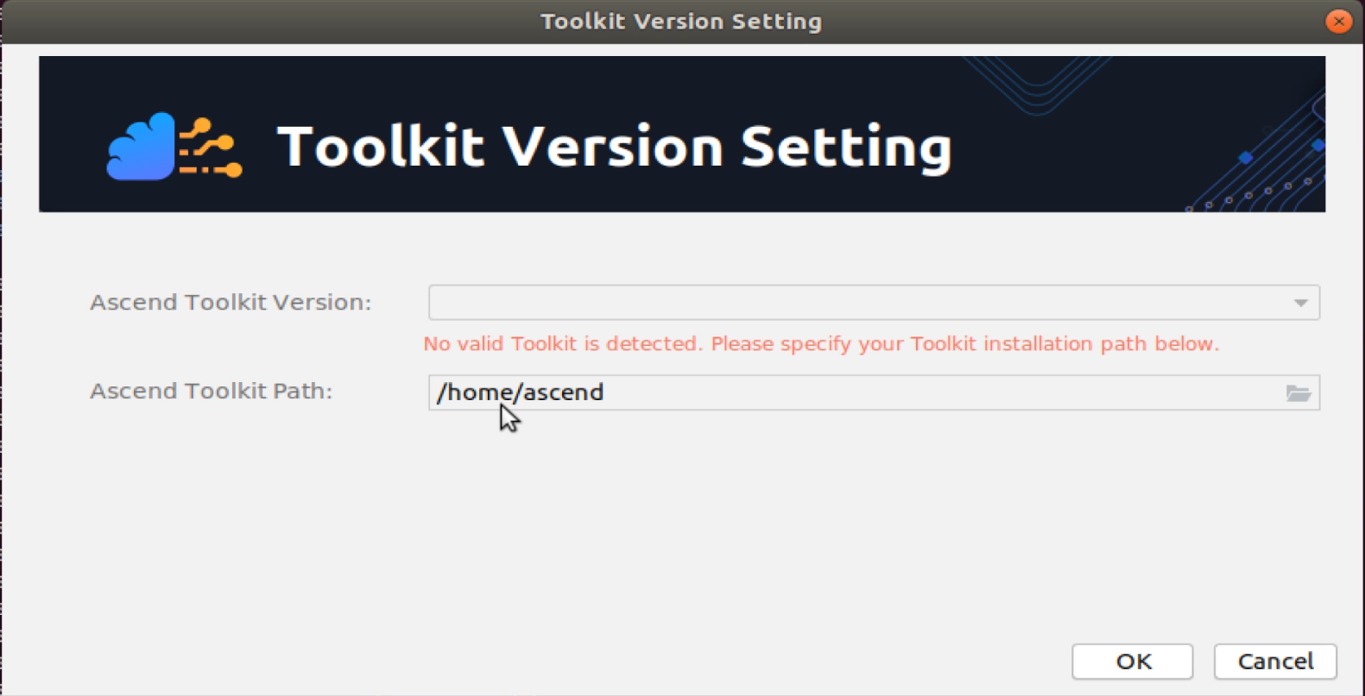
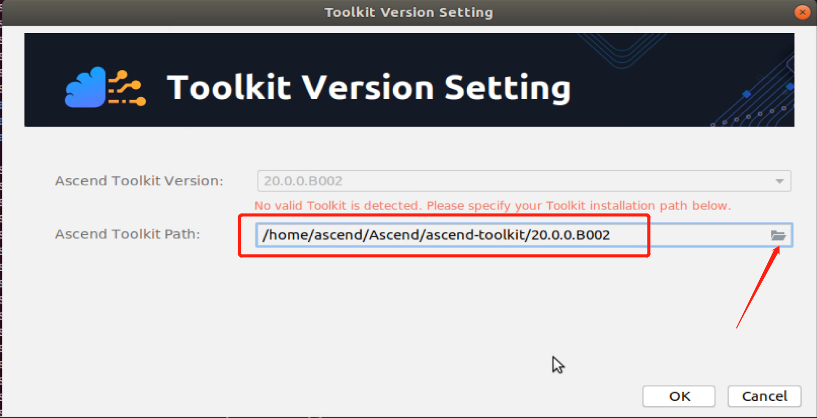
Installing MindStudio (Continued)
4. In the Toolkit Version Setting dialog box, select the Toolkit directory (including the version number).
Notes:
开发套件和MindStudio是各自独立安装的，但是使用的时候要结合到一起使用，即让MindStudio认识开发套件的安装位置，就像让Eclipse认识JDK，让Clion认识MinGW一样。

Slide 42
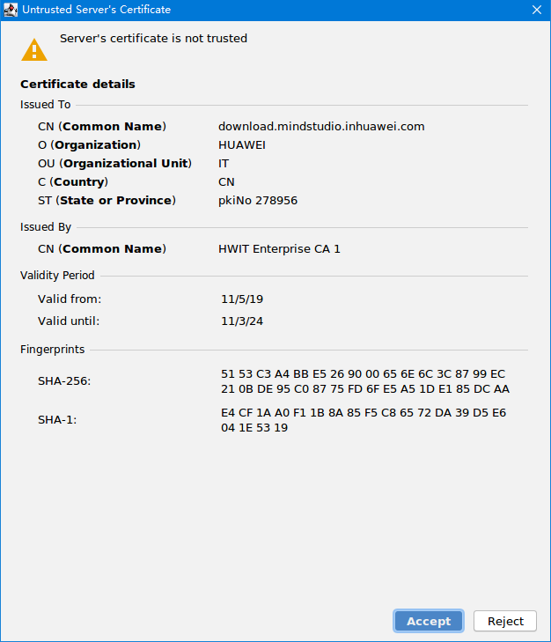
Installing MindStudio (Continued)
4. In the displayed authorization dialog box, click Accept.
Notes:
临门一脚了。

Slide 43
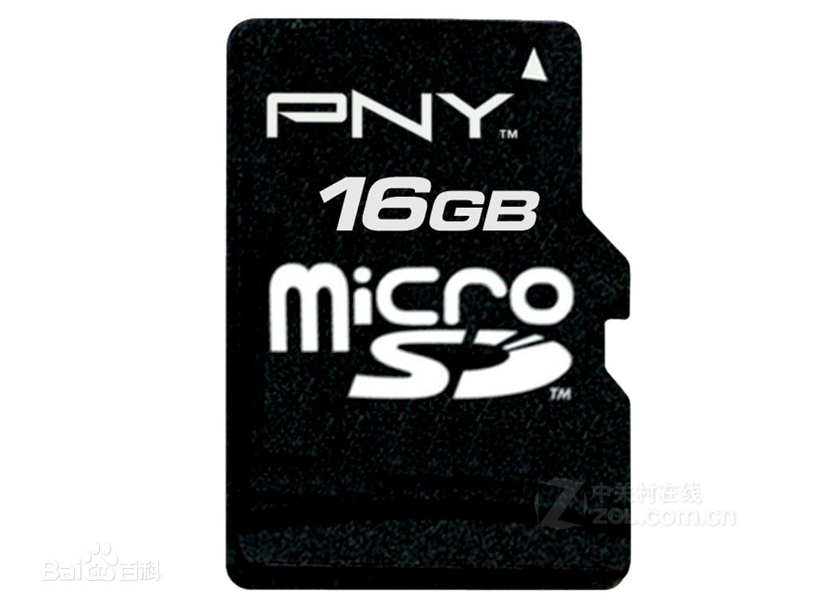
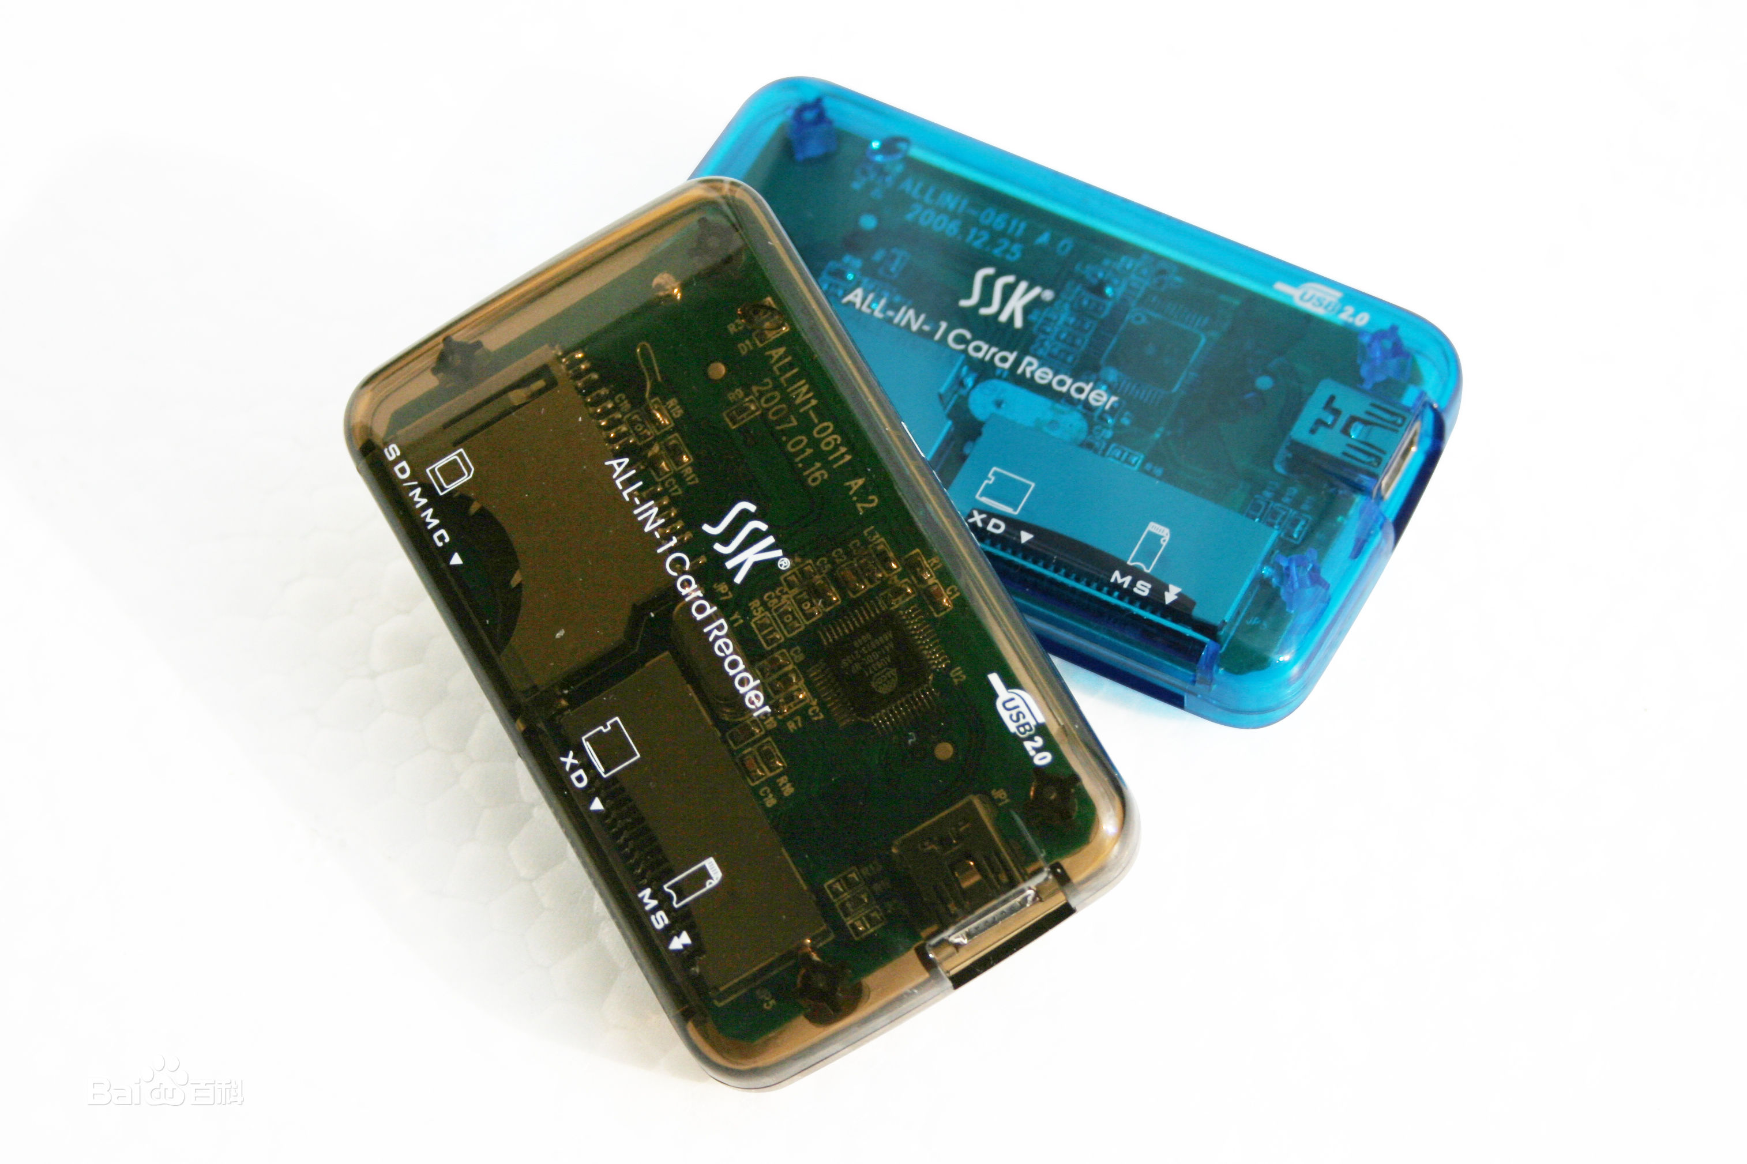
Installing the Operating Environment – Preparing Software and Hardware
Hardware: a 32–128 GB microSD card and a card reader for creating a bootable SD card.
Notes:
搭建运行环境即在Atlas200DK上安装操作系统及软件包，这一步骤已分装成脚本，按照后续的操作指导执行即可。
Atlas200DK的存储是由一张MicroSD卡来承载的，这张卡就相当于200DK的硬盘，我们将在这张卡上安装操作系统和软件包，然后插进Atlas200DK的卡槽中，上电即可。

Slide 44
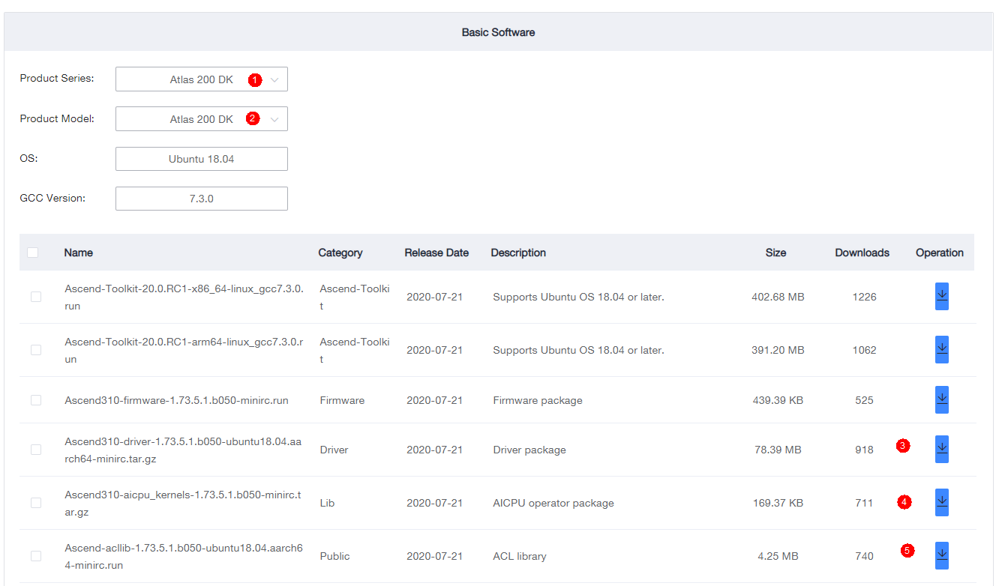
Installing the Operating Environment – Preparing Software and Hardware
Software
1. Download required runfiles from: https://www.huaweicloud.com/intl/en-us/ascend/resource/Software
Notes:
请下载⑤⑥⑦所指向的包，放到同一个目录下
其中⑤是Atlas200DK的硬件驱动包
⑥是AICPU算子库包
⑦是AscendCL运行库包

Slide 45
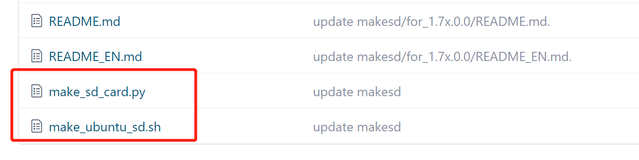
Installing the Operating Environment – Preparing Software and Hardware
2. Download the Ubuntu18.04.4-server-arm64 package from: https://mirrors.huaweicloud.com/ubuntu-cdimage/releases/18.04.4/release/ubuntu-18.04.4-server-arm64.iso
3. Download the following two files from: https://gitee.com/ascend/tools/tree/master/makesd/for_1.7x.0.0
Save all the downloaded files to the same directory.
Notes:
下载红色方框圈起来的两个脚本，放到跟软件包同一个目录下
这些文件操作请都在开发环境上做

Slide 46
Installing the Operating Environment – Installation Procedure
Perform the following operations as the root user:
1. Configure an available pip source.
2. Run the following commands:
pip3 install pyyaml
apt-get install qemu-user-static binfmt-support python3-yaml gcc-aarch64-linux-gnu g++-aarch64-linux-gnu
3. Go to the package directory.

Slide 47
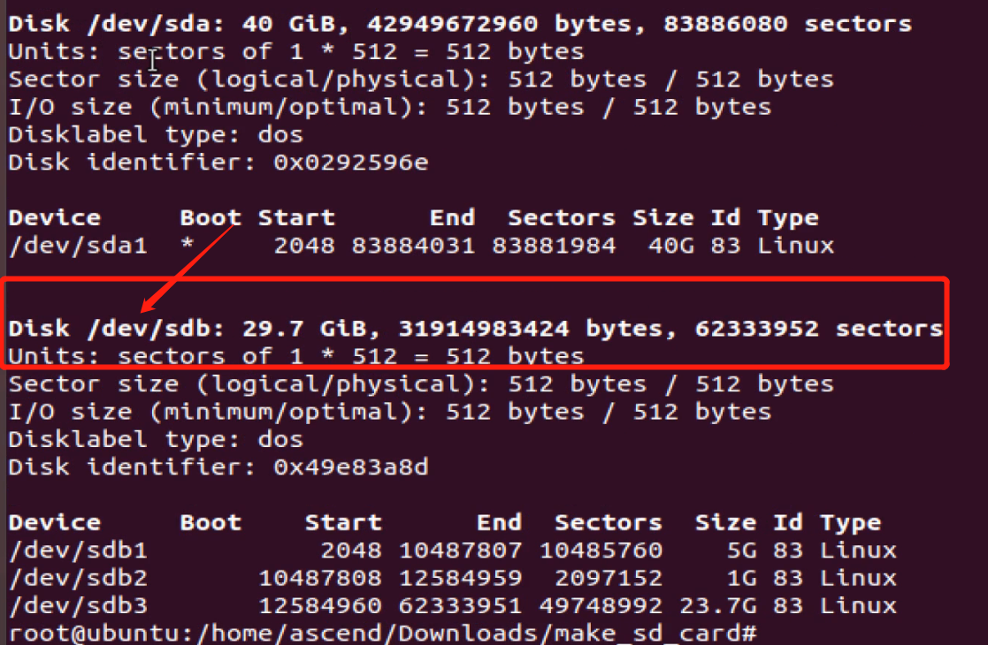
Installing the Operating Environment – Installation Procedure (Continued)
4. Run the following command: fdisk -l
Check the name of the USB device corresponding to the SD card.
In this example, a 32 GB SD card is used. Therefore, the 29.7 GB device is the required device, named /dev/sdb.
5. Run the following command:
python3 make_sd_card.py local /dev/sdb
6. A bootable SD card is created. Remove the SD card from the card reader, insert it into the card slot of the Atlas 200 DK, and power on the Atlas 200 DK.

Slide 48
Installing the Operating Environment – Connecting the Development and Operating Environments
1. After the Atlas 200 DK is booted successfully and the four LEDs are on, use a USB Type-C cable to connect the Atlas 200 DK to the development environment PC.
2. Download the configure_usb_ethernet.sh script to the development environment from: https://gitee.com/ascend/tools/tree/master/configure_usb_ethernet/for_1.7x.0.0
3. Go to the script directory and run the script as the root user.
./configure_usb_ethernet.sh
4. Ping the operating environment.
ping 192.168.1.2
If the ping shows to be successful, the configuration is complete.
The development and operating environments have been set up.
Development environment (PC)
Default IP: 192.168.1.166
USB Type-C
Default IP: 192.168.1.2
Operating Environment (Atlas 200 DK)
Notes:
这里只讲解USB线缆连接方式，需要其他连接方式的读者，可以参考https://support.huaweicloud.com/usermanual-A200dk_3000/atlas200dk_02_0018.html

Slide 49
Atlas 300 Environment Setup

Slide 50

Setting up Development and Operating Environments
Development environment
Operating environment
Layer 2 Software layer
Mind Studio
Driver, Firmware, rufiles, ...
Layer 1 OS layer
Ubuntu-18.04.4-desktop-amd64
Ubuntu-18.04.4-server-amd64
Layer 0 Hardware layer
Atlas300
Notes:
跟其他编程语言一样，昇腾/Atlas系列设备的开发和运行环境也是可以分开的。在开发环境上开发代码，编译成二进制；在运行环境上运行。除了开发和编译之外，开发环境上的工具还能实现其他的一些功能，诸如模型转换、设备管理 （即运行环境管理）、精度比对、profiling等等。而运行环境则除了基本的应用运行之外，还能运行某些调试、信息收集工具等，以辅助代码的调试调优、问题定位。
开发环境可自行选用任何计算机，笔记本、台式机、服务器均可，但要注意，操作系统必须是Ubuntu18.04.4-desktop-amd64，只有在这个操作系统上才能正常运行开发环境的核心组件——MindStudio。
Atlas300和华为云Ai1产品本质上是一样的，安装过程也基本完全一致，这里为了简化操作，选用华为云Ai1产品来进行讲解。
Ai1产品的通用CPU是x86架构的，故其操作系统需要是Ubuntu-18.04.4-server-amd64而非arm64.

Slide 51
Setting up the Development Environment
Install OS
Install Toolkit
Install MindStudio
Notes:
搭建开发环境总体分三个步骤，即安装操作系统，安装开发套件以及安装MindStudio。
其中，安装操作系统部分，请自行安装Ubuntu18.04.4-desktop-amd64系统到您的计算机上，本课程暂不展开讲解。
安装开发套件和MindStudio会在下文中详细进行展示。
整个“搭建开发环境”都是在您自己的计算机上，而非远端的AI1环境上完成的。
当然，您也可以选择在AI1上完成这些步骤，动作完全一样，即开发&运行环境合设是行得通的。

Slide 52
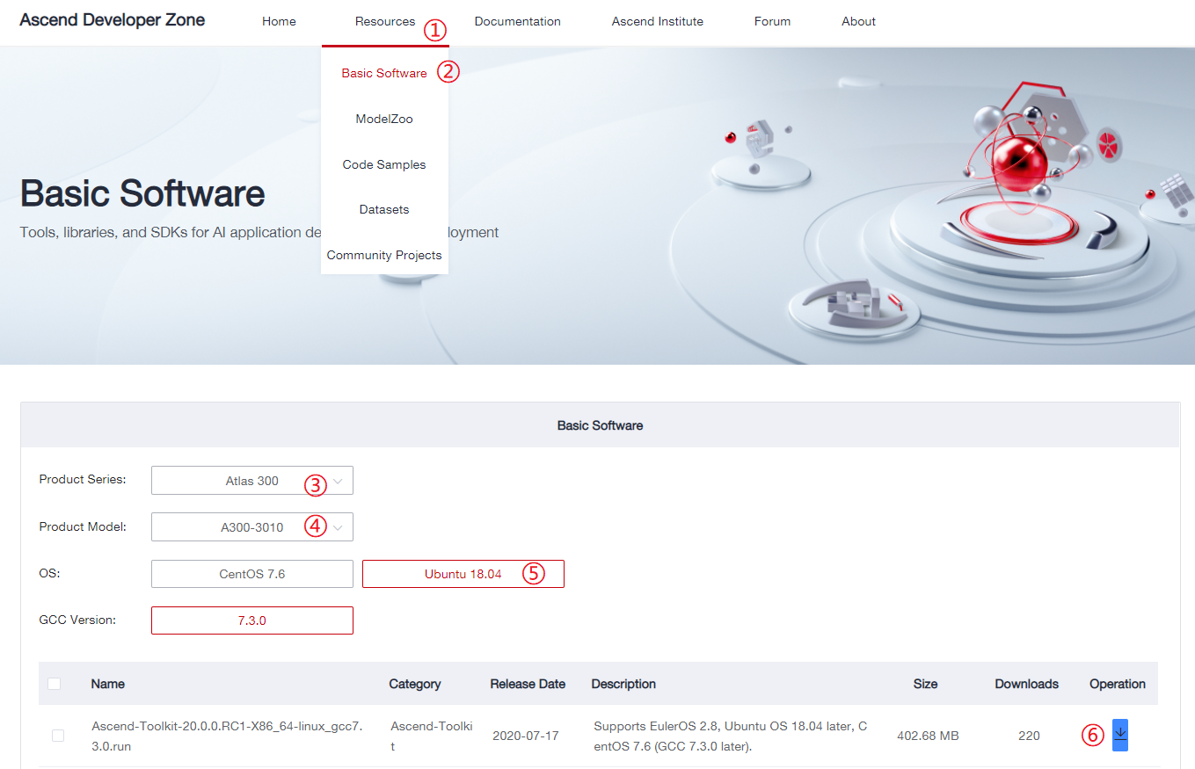
Installing Toolkit – Downloading Runfiles
https://www.huaweicloud.com/intl/en-us/ascend/resource/Software
Notes:
访问屏幕下方的网址，进入昇腾开发者社区的资源中心->基础软件下载，
③：“产品系列”选择“Atlas300”，
④：“产品型号”选择“A300-3010”，注意，A300-3000针对的是运行环境是ARM架构的包，我们选用的运行环境，华为云Ai1，是基于x86架构的，故选择A300-3010
⑤：这里我们选择我们使用的开发环境操作系统，即ubuntu18.04
⑥：然后下载以“Ascend-Toolkit”开头的包。
这里要注意”产品型号“这里要选择正确，A300-3000指的是宿主机CPU是ARM架构的，A300-3010则指的是宿主机CPU是x86架构的。我们选用的Ai1产品，其CPU是x86架构的。开发机是x86，运行机也是x86，故只需要这一个开发套件即可。

Slide 53
Installing Toolkit – Replacing Software Sources
Perform the following operations as the root user:
Modify the /etc/apt/sources.list file.
Replace the ubuntu18.04-amd64 source addresses with valid ones.
Save the file and run the following command: apt-get update
If a message similar to the following is displayed, the execution is successful.

Slide 54
Installing Toolkit – Creating a Service User
Perform the following operations as the root user:
1. Create a user.
groupadd HwHiAiUser //Create the HwHiAiUser user group.
useradd -g HwHiAiUser -d /home/HwHiAiUser -m HwHiAiUser
2. Modify the /etc/sudoers file.
Add the following line under
# User privilege Specification:
HwHiAiUser ALL=(ALL:ALL) ALL
Notes:
这里边步骤二是为了让H我HiAiUser用户有权限执行sudo命令，从而能够以root权限执行一些安装指令

Slide 55
Installing Toolkit – Installing System Dependencies and Python
Perform the following operations as a common user (HwHiAiUser):
Install the dependencies:
sudo apt-get install -y gcc g++ make cmake zlib1g zlib1g-dev libsqlite3-dev openssl libssl-dev libffi-dev unzip pciutils net-tools
2. Install Python 3.7.5:
wget https://www.python.org/ftp/python/3.7.5/Python-3.7.5.tgz
tar -zxvf Python-3.7.5.tgz
cd Python-3.7.5
./configure --prefix=/usr/local/python3.7.5 --enable-shared
make
sudo make install
sudo cp /usr/local/python3.7.5/lib/libpython3.7m.so.1.0 /usr/lib
sudo ln -s /usr/local/python3.7.5/bin/python3 /usr/bin/python3.7
sudo ln -s /usr/local/python3.7.5/bin/pip3 /usr/bin/pip3.7
sudo ln -s /usr/local/python3.7.5/bin/python3 /usr/bin/python3.7.5
sudo ln -s /usr/local/python3.7.5/bin/pip3 /usr/bin/pip3.7.5

Slide 56
Installing Toolkit – Installing Python Dependency
Perform the following operations as a common user (HwHiAiUser):
1. Create a .pip directory in the $HOME directory.
cd ~; mkdir .pip; cd .pip
2. Create a pip.conf file in the .pip directory and fill in the following content (you can also choose other pip sources):
[global]
index-url = http://pypi.douban.com/simple
[install]
trusted-host = pypi.douban.com
3. Save the pip.conf file.
4. Install the dependencies:
pip3.7.5 install attrs psutil decorator numpy protobuf==3.11.3 scipy sympy cffi grpcio grpcio-tools requests --user

Slide 57
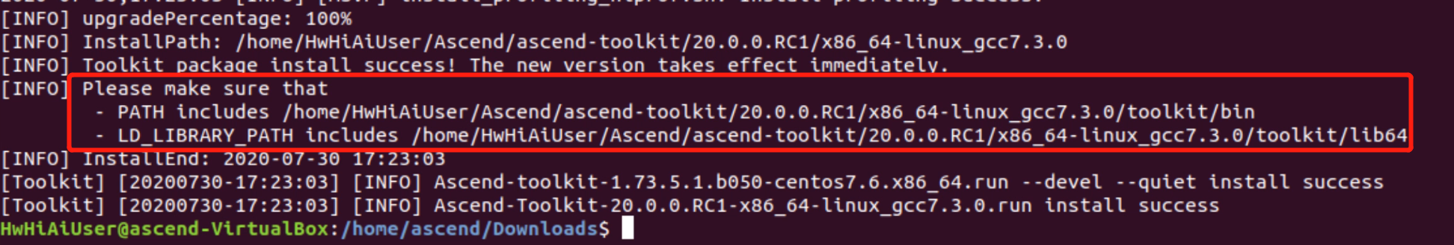
Installing Toolkit – Executing Runfiles
Perform the following operations as a common user (HwHiAiUser):
1. Go to the runfile directory.
2. Add the execute permission on the runfiles:
chmod +x *.run
3. Execute the runfiles:
./Ascend-Toolkit-20.0.0.RC1-X86_64-linux_gcc7.3.0.run --install
4. If messages similar to the following are displayed, the installation is successful.
5. Configure the environment variables as prompted.
Notes:
安装前请再次确认您使用的是ubuntu18.04.4-desktop-amd64

Slide 58
Installing MindStudio – Downloading tar.gz. Package
Download MindStudio 2.0.0 (beta2) from https://www.huaweicloud.com/intl/en-us/ascend/resources/tools/mindStudio/download.
The name of the downloaded package should be MindStudio_2.0.0-beta2_ubuntu18.04-x86_64.tar.gz.

Slide 59
Installing MindStudio – Installing Dependencies
Perform the following operations as a common user (HwHiAiUser):
1. Install the system dependencies:
sudo apt-get install -y gcc g++ make cmake unzip zlib1g-dev libbz2-dev libsqlite3-dev libssl-dev libxslt1-dev libffi-dev xterm firefox xdg-utils fonts-droid-fallback fonts-wqy-zenhei fonts-wqy-microhei fonts-arphic-ukai fonts-arphic-uming openjdk-8-jdk
2. Install the Python dependency:
pip3.7.5 install attrs psutil decorator numpy protobuf==3.11.3 scipy sympy cffi gnureadline coverage pylint matplotlib PyQt5==5.14.0 grpcio grpcio-tools requests tensorflow==1.15 --user
3. Append the following two lines to the ~/.bashrc file and save the file:
export JAVA_HOME=/usr/lib/jvm/java-8-openjdk-amd64
export PATH=$JAVA_HOME/bin:$PATH
4. Run the following command:
source ~/.bashrc

Slide 60
Installing MindStudio
Perform the following operations as a common user:
1. Go to the directory where MindStudio_2.0.0-beta2_ubuntu18.04-x86_64.tar.gz is stored and run the following command:
tar zxvf MindStudio_2.0.0-beta2_ubuntu18.04-x86_64.tar.gz; cd MindStudio-ubuntu/bin;./MindStudio.sh
2. If command outputs similar to the following are displayed, run the command as prompted.
3. After MindStudio is launched for the first time, the Import MindStudio Settings dialog box is displayed. Select Do not import settings and click OK.

Slide 61
Installing MindStudio (Continued)
4. In the Toolkit Version Setting dialog box, select the Toolkit directory (including the version number).

Slide 62
Installing MindStudio (Continued)
5. In the displayed authorization dialog box, click Accept.

Slide 63
Setting Up the Operating Environment
Prepare Atlas300 environment
Install OS
Execute runfiles
Notes:
搭建开发环境总体分三个步骤，即安装操作系统，安装开发套件以及安装MindStudio。
其中，安装操作系统部分，请自行安装Ubuntu18.04.4-desktop-amd64系统到您的计算机上，本课程暂不展开讲解。
安装开发套件和MindStudio会在下文中详细进行展示。
整个“搭建开发环境”都是在您自己的计算机上，而非远端的AI1环境上完成的。
当然，您也可以选择在AI1上完成这些步骤，动作完全一样，即开发&运行环境合设是行得通的。

Slide 64
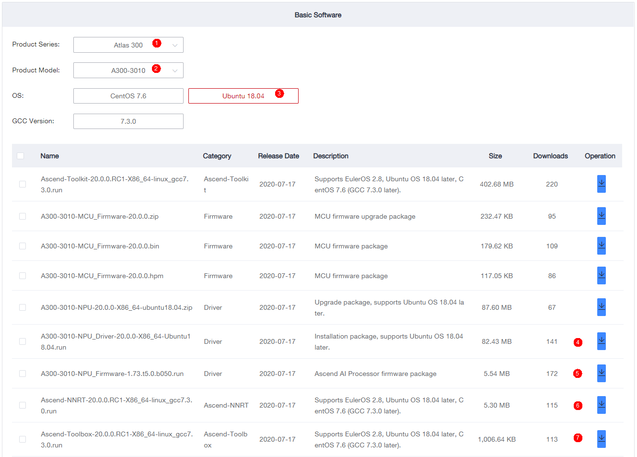
Installing the Operating Environment – Obtaining Runfiles
Software
Download required runfiles from: https://www.huaweicloud.com/intl/en-us/ascend/resource/Software
Notes:
请将四个红框圈起来的文件下载下来，放到AI1上同一个目录下

Slide 65
Installing the Operating Environment – Replacing Software Sources
Perform the following operations as the root user:
Modify the /etc/apt/sources.list file.
Replace the ubuntu18.04-amd64 source addresses with valid ones.
Save the file and run the following command: apt-get update
If a message similar to the following is displayed, the execution is successful.

Slide 66
Installing the Operating Environment – Creating a Service User
Perform the following operations as the root user:
1. Create a user.
groupadd HwHiAiUser //Create the HwHiAiUser user group.
useradd -g HwHiAiUser -d /home/HwHiAiUser -m HwHiAiUser
2. Modify the /etc/sudoers file.
Add the following line under
# User privilege Specification:
HwHiAiUser ALL=(ALL:ALL) ALL
3. Run the following command:
apt-get install dkms

Slide 67
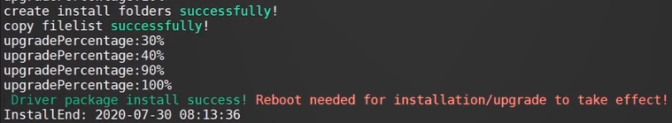
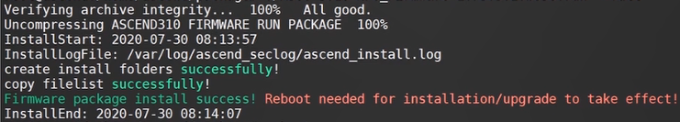
Installing the Operating Environment – Installation Procedure
Perform the following operations as the root user:
1. Go to the runfile directory and run the following commands:
chmod +x *.run
./A300-3010-NPU_Driver-20.0.0-X86_64-Ubuntu18.04.run --full
./A300-3010-NPU_Firmware-1.73.t5.0.b050.run --full
2. Run the reboot command to reboot the server.

Slide 68
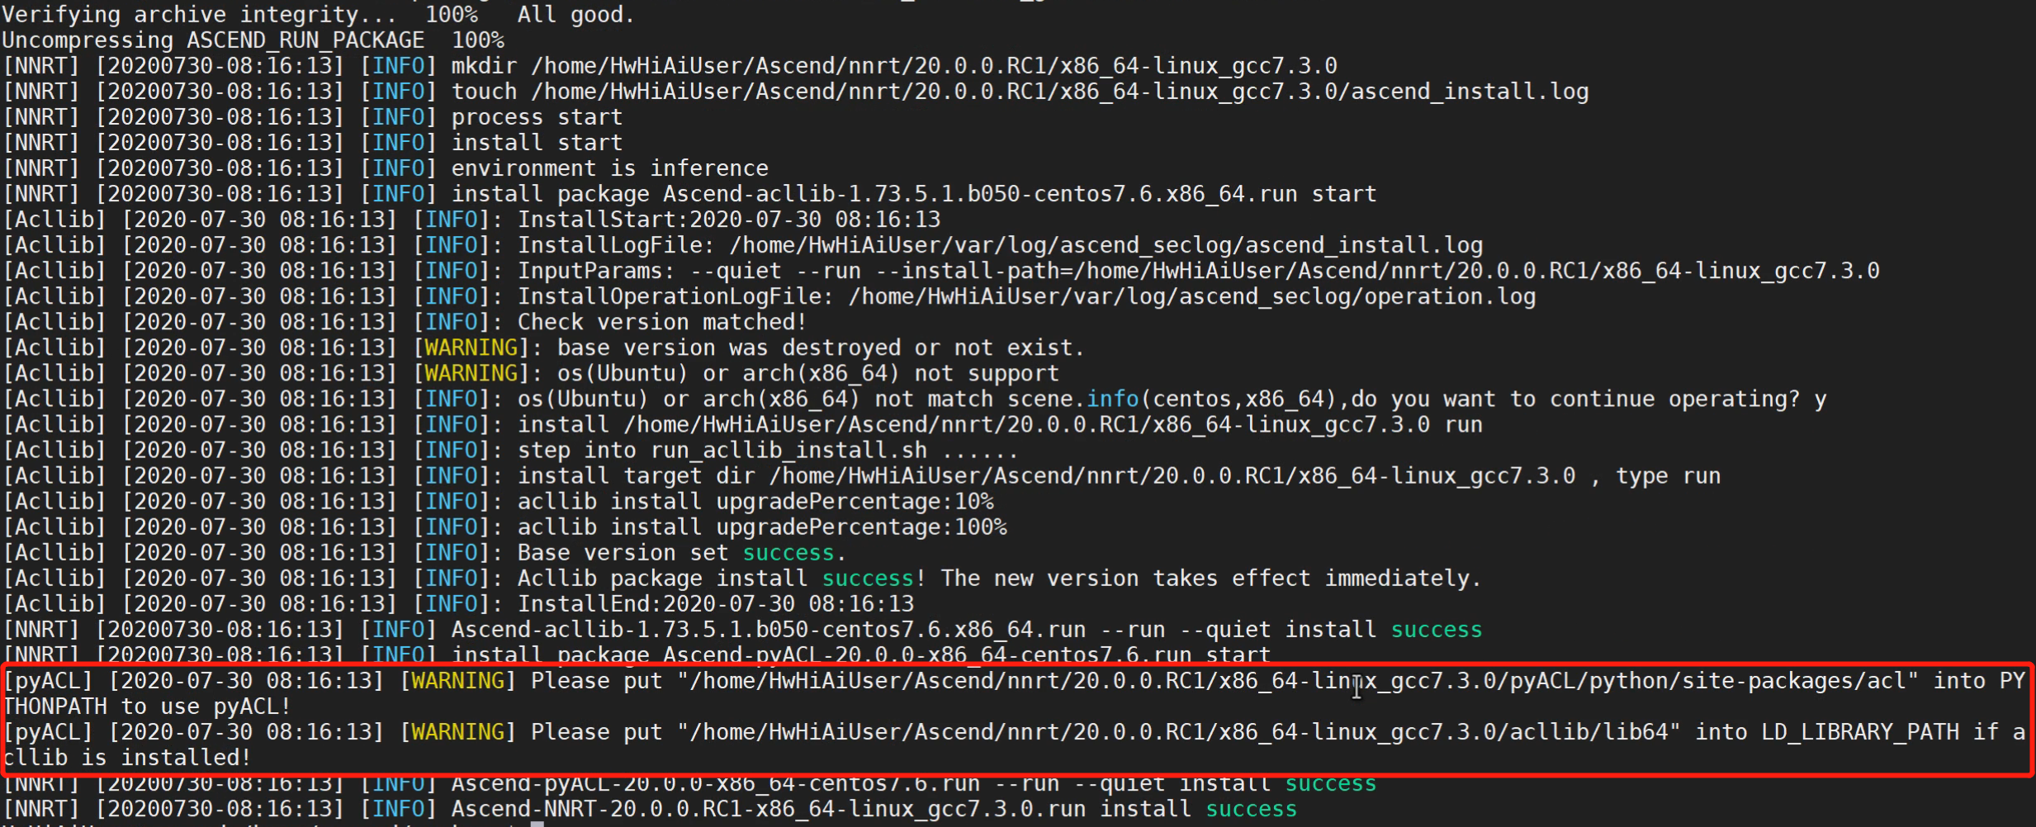
Installing the Operating Environment – Installation Procedure
Perform the following operations as the HwHiAiUser user:
1. Go to the runfile directory and run the following command:
./Ascend-NNRT-20.0.0.RC1-X86_64-linux_gcc7.3.0.run --install
2. Set the environment variables according to the warning prompt.

Slide 69
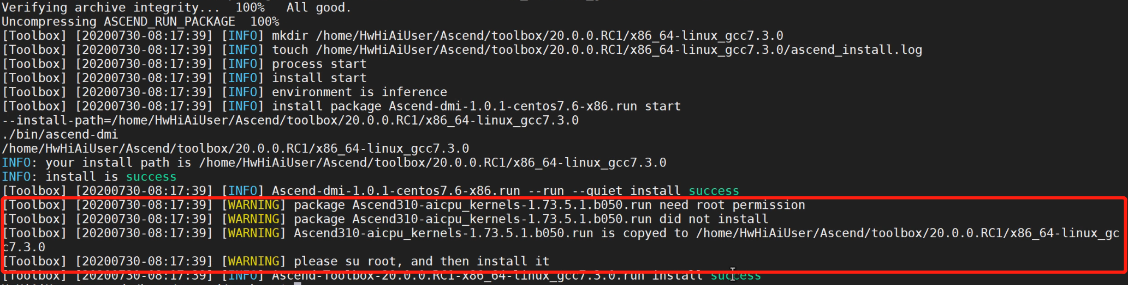
Installing the Operating Environment – Installation Procedure
Perform the following operations as the HwHiAiUser user:
1. Go to the runfile directory and run the following command:
./Ascend-Toolbox-20.0.0.RC1-X86_64-linux_gcc7.3.0.run --install
2. Go to the /home/HwHiAiUser/Ascend/toolbox/20.0.0.RC1/x86_64-linux_gcc7.3.0 directory as prompted and run the following commands as the root user (do reboot the server after the commands are executed):
./Ascend310-aicpu_kernels-1.73.5.1.b050.run --full

Slide 70
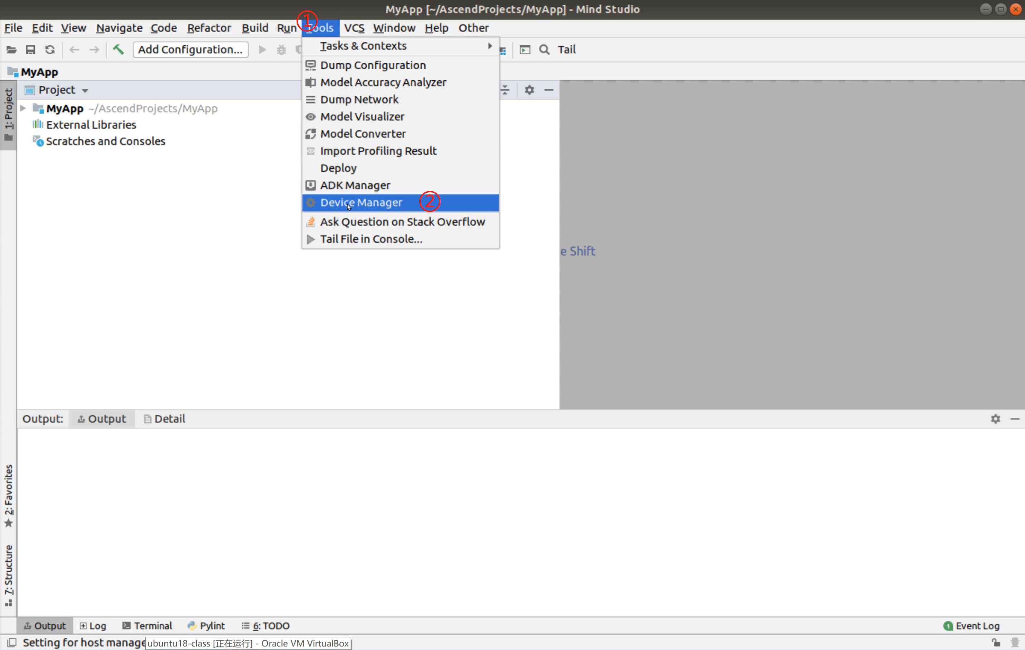
Connecting the Development and Operating Environments
1. Launch MindStudio in the development environment.
2. Navigate to Device Manager.

Slide 71
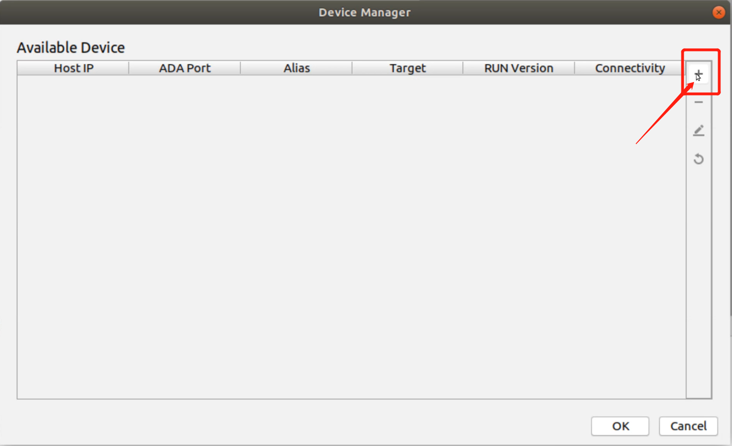
Connecting the Development and Operating Environments
3. Click + in the upper right corner to add the operating environment.

Slide 72


Connecting the Development and Operating Environments
3. In the dialog box that is displayed, enter the IP address of the operating environment and click OK.
4. If the connection is successful, the operating environment is added to the list.

Slide 73
MindStudio Features Walkthrough

Slide 74

Project Management
In the project management window, you can create an application project or operator project and add models and data to the project.
Notes:
工程内各目录因不用应用而异，典型的目录用途如下：
Build：放置编译构建相关临时文件
Caffe_model：放置caffe原始模型
Data：放置准备用作推理的数据
Inc：放置头文件
Out：放置编译后的二进制文件
Script：放置辅助脚本
Src：放置代码源文件和编译用的CMakeLists.txt等

Slide 75


ADK Manager
ADK Manager allows you to manage ADKs of different versions. However, only one version can be activated for building your project at a time.
Notes:
ADK之于MindStudio，就相当于JDK之于Intellij Idea，MinGW之于Clion，MindStudio只是IDE，本身是无法完成编译等工作的，其核心工作是通过ADK来完成的，也就是安装开发环境时安装的“开发套件”。
但既然ADK和MindStudio分开了，现在MindStudio是可以管理多个版本的ADK的，需要使用哪个版本，将其激活即可。

Slide 76

ADK Manager (Continued)
On the Cross Compiler tab page, you can manage cross compilers. They are applicable to the scenario where the operating environment and development environment have different architectures. In this case, you can perform building using the compiler in the operating environment.
Notes:
所谓“交叉编译”，即开发环境和运行环境架构不同时的编译活动，在Atlas200DK场景下，运行环境是ARM架构的，开发环境是x86架构的，如果用x86自己的编译器来编译，编译的结果肯定无法在arm环境上运行。
故在x86环境上，使用arm的编译器来编译，编译出来的结果就能在arm上跑起来了。

Slide 77


Build and Run
The build process is completed in the development environment, while the run process is completed in the operating environment. Therefore, you need to configure the IP of the operating environment and ensure the connectivity in advance.

Slide 78


Device Manager
Device Manager allows you to connect to the operating environment from the development environment so that executable files can be transferred to the operating environment for execution.

Slide 79


Model Converter
Model Converter converts pre-trained Caffe or TensorFlow models into a model adapted to the Ascend AI Processor.

Slide 80

Log
Operating environment log messages are directly printed to the Log window, sparing you the effort of obtaining log files from the operating environment.

Slide 81


Profiling
You can enable AI Core profiling in task traces or system traces as required.

Slide 82

Profiling (Continued)
After profiling is completed, the profiling result page is displayed.

Slide 83


Model Visualizer
Model Visualizer presents the network topology of an offline model (.om) and details about all its operators.

Slide 84
Wrap-up
This course gives an overview of the Huawei Ascend AI full-stack, all-scenario solution, ranging from the hardware products, to software architecture, and the toolchain. Specifically, it provides step-by-step instructions for setting up the development and operating environments for Atlas 200 DK, Atlas 300/Ai1, and ModelArts in addition to the rundown of typical features of the MindStudio IDE.
Welcome to join us in the Ascend forum and feel free to post your comments and questions here.

Slide 85

Ascend Developer Zone
https://www.huaweicloud.com/intl/en-us/ascend/home.html

